Slide 1
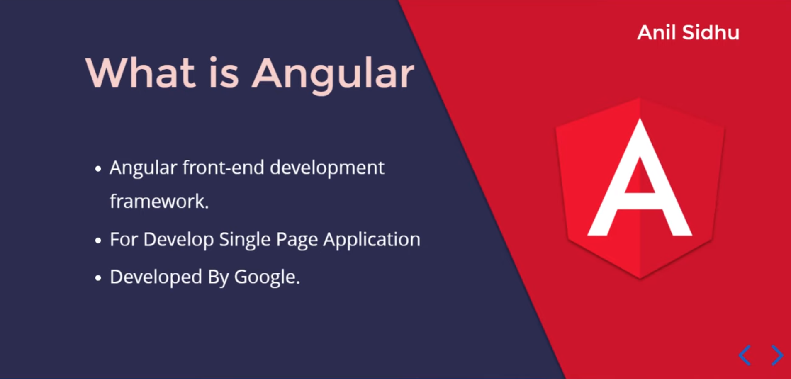

Slide 2
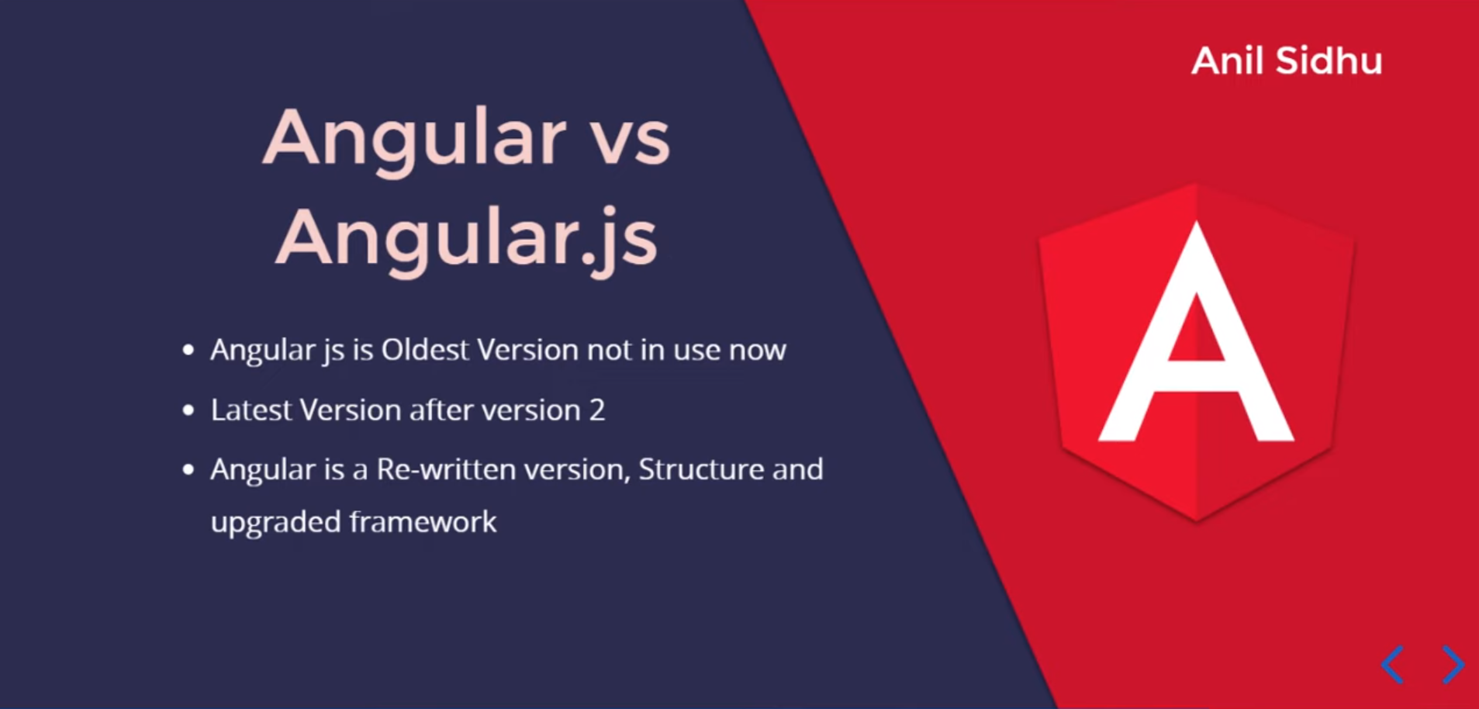

Slide 3
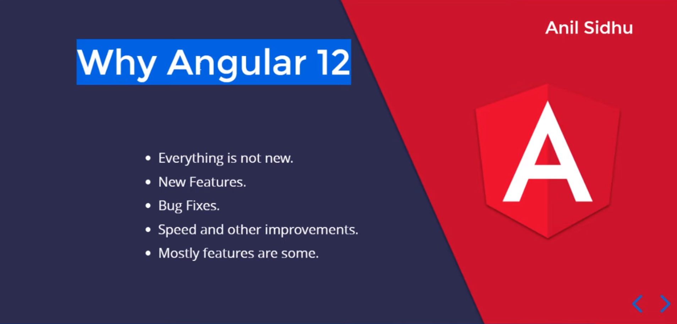

Slide 4
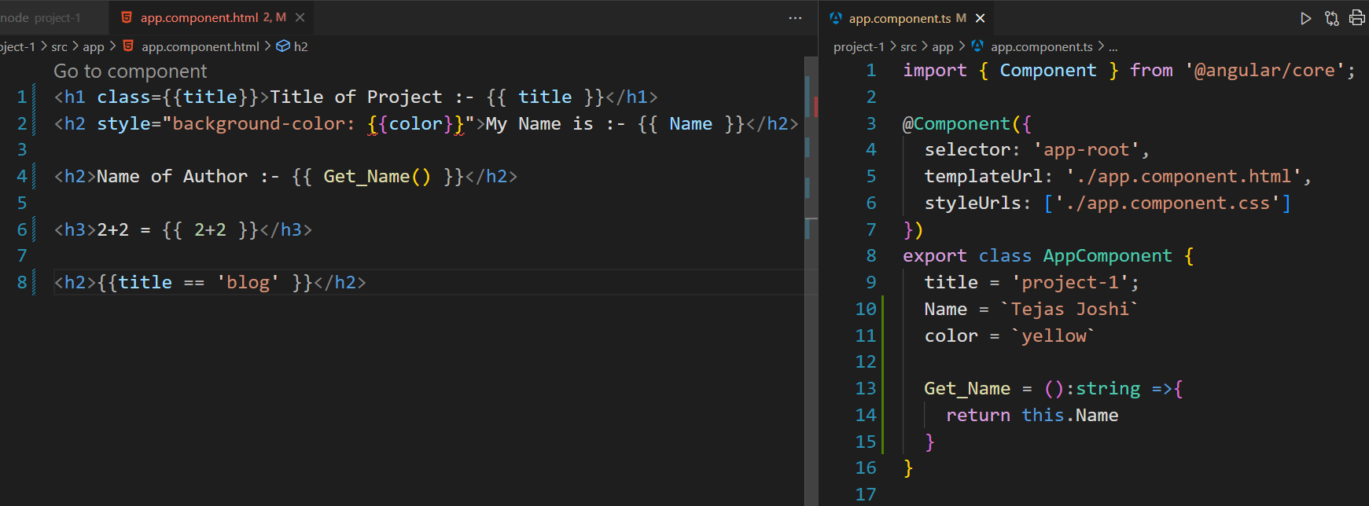
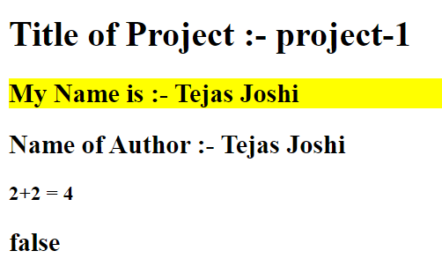
Interpolation

Slide 5
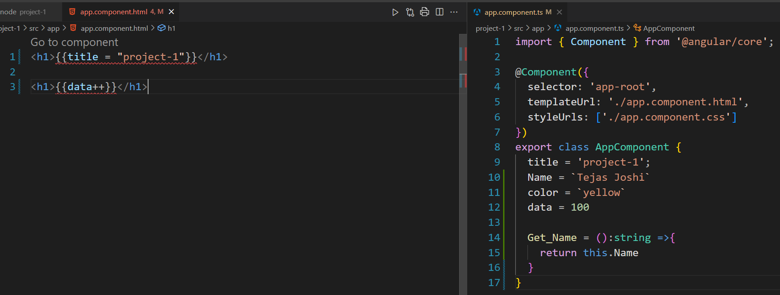
Interpolation

Slide 6
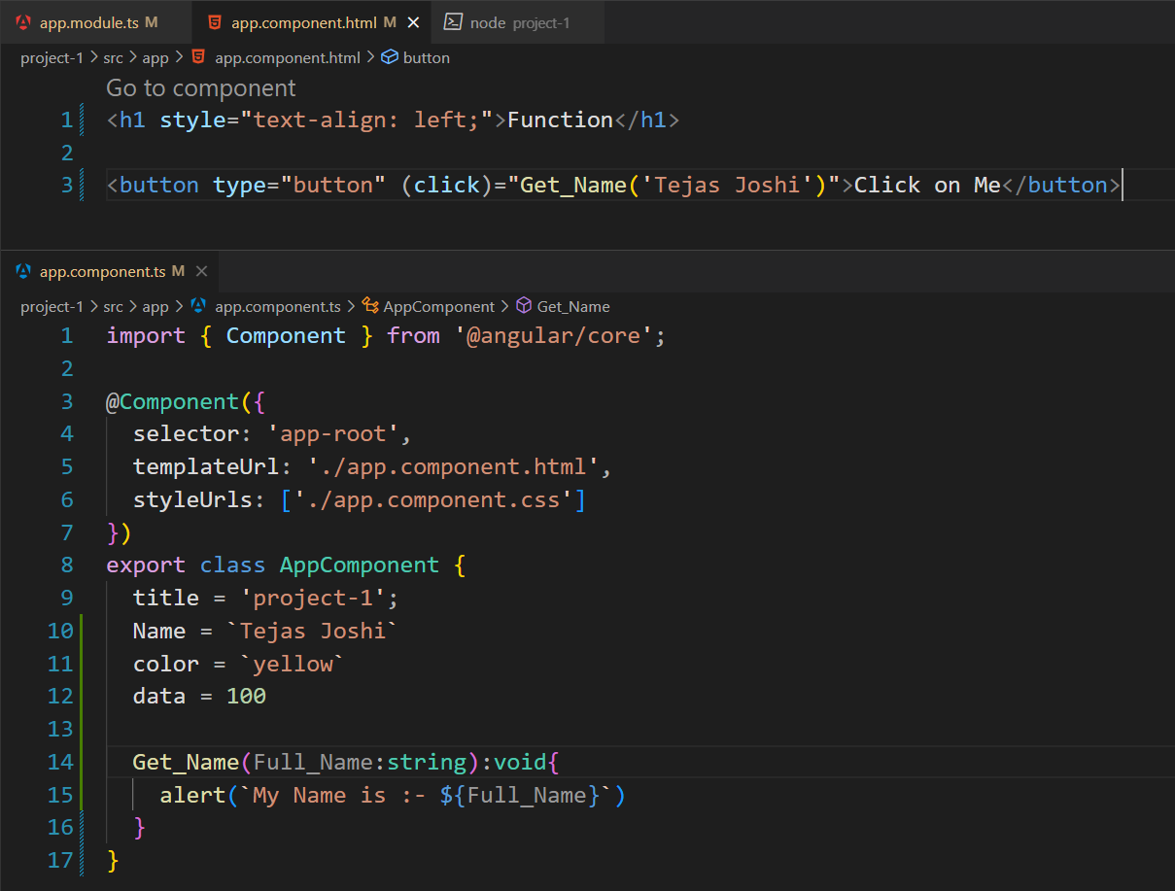
Functions & Events

Slide 7
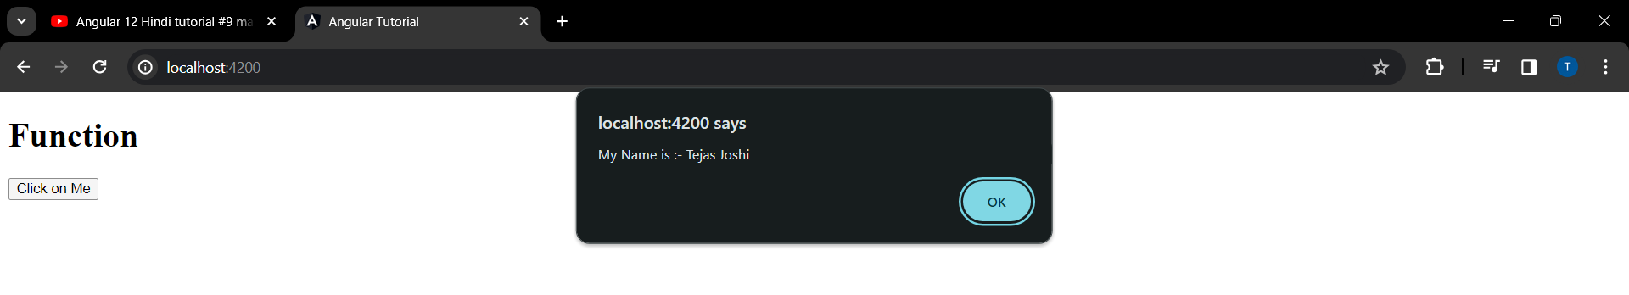
Function & Events

Slide 8
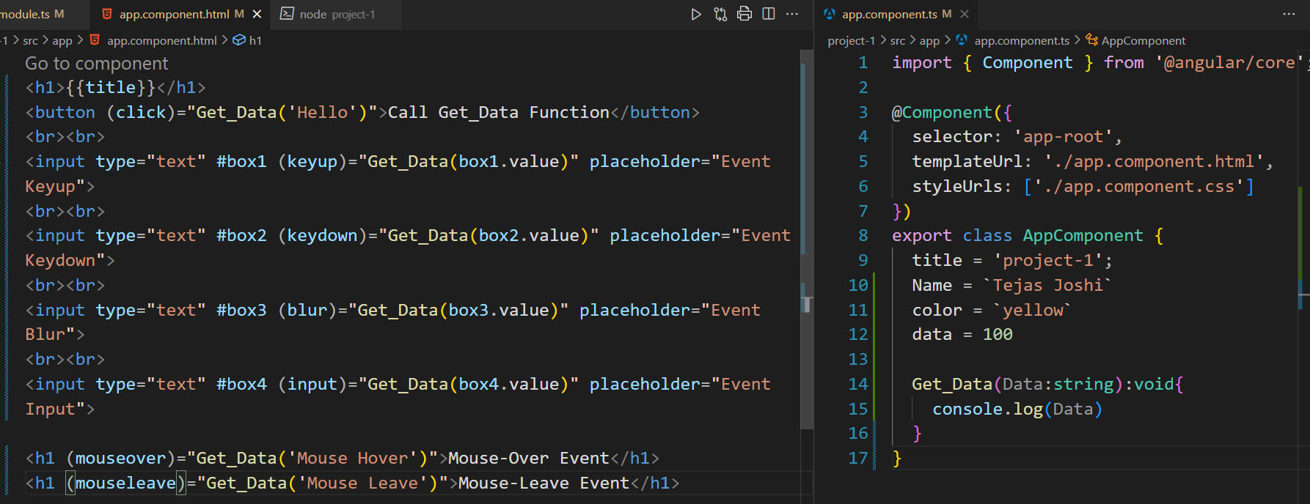
Function & Events

Slide 9
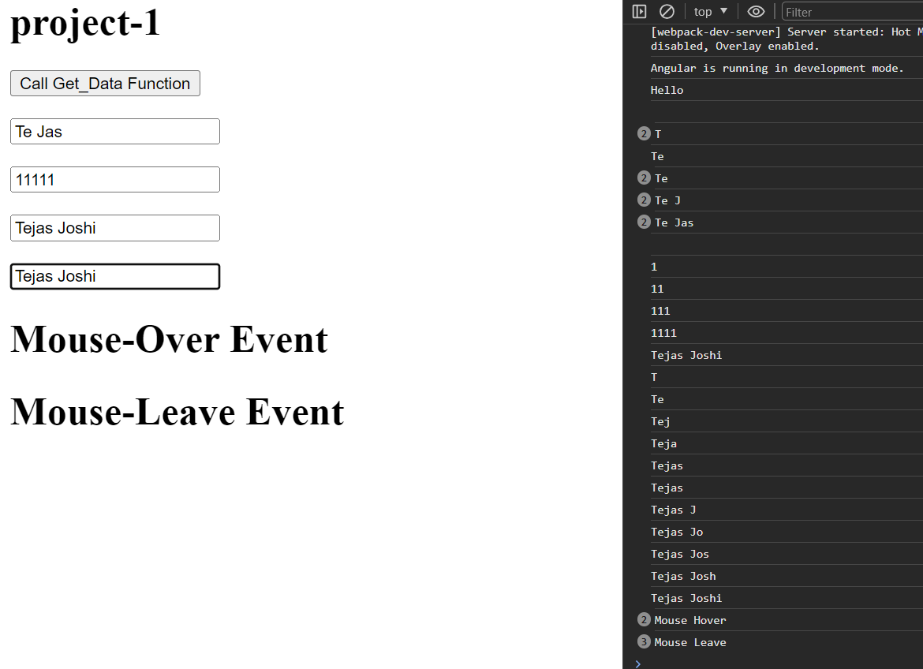
Function & Events

Slide 10
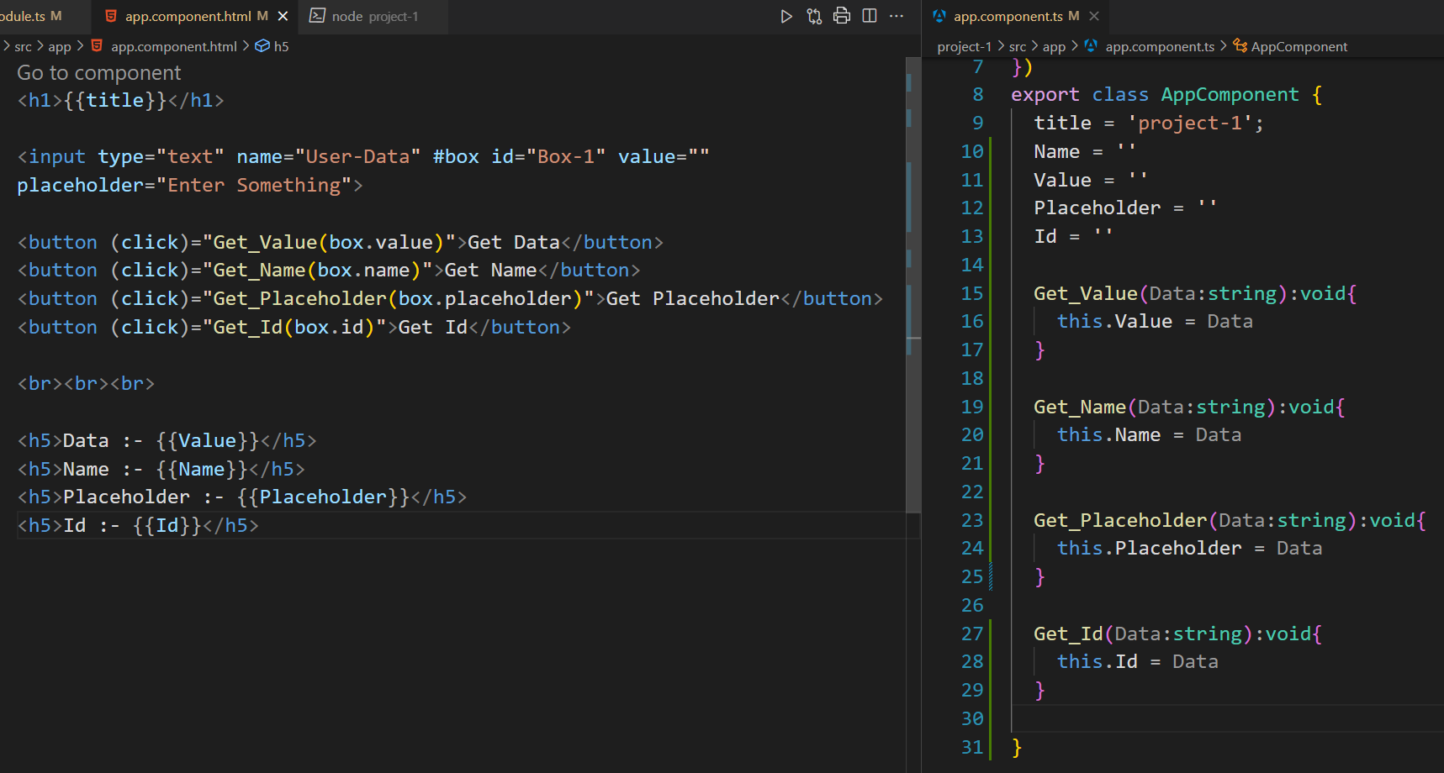
Function & Events

Slide 11
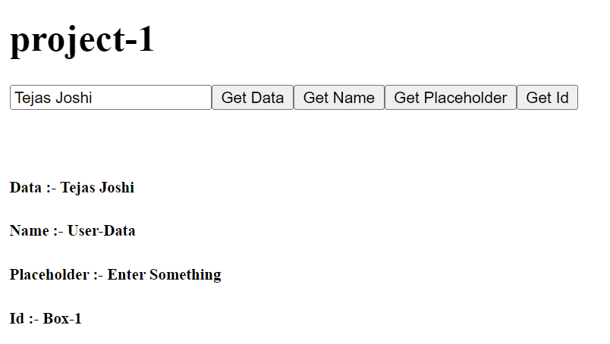
Function & Events

Slide 12
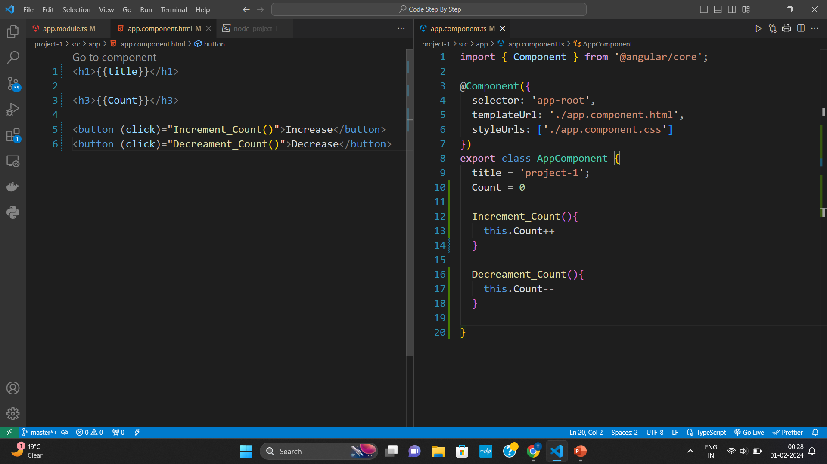
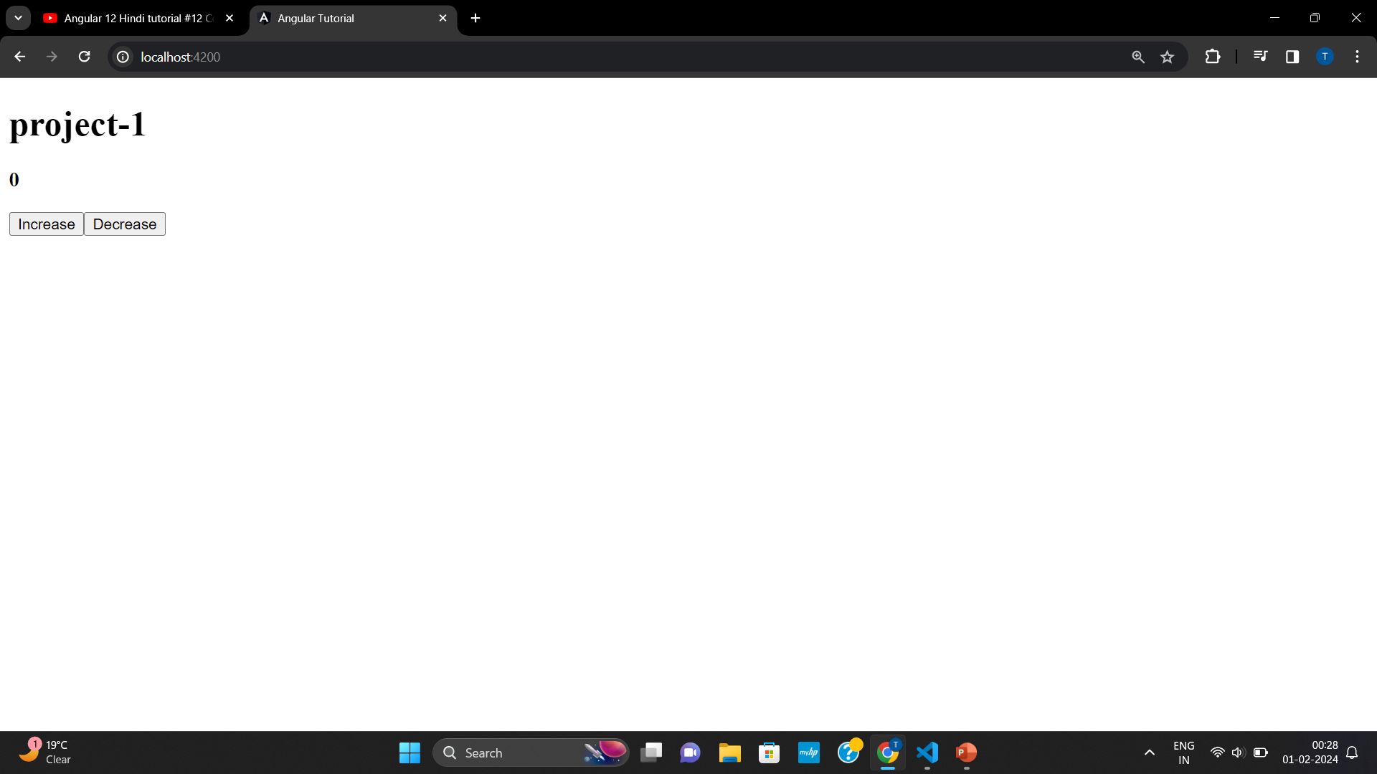
Function & Events

Slide 13
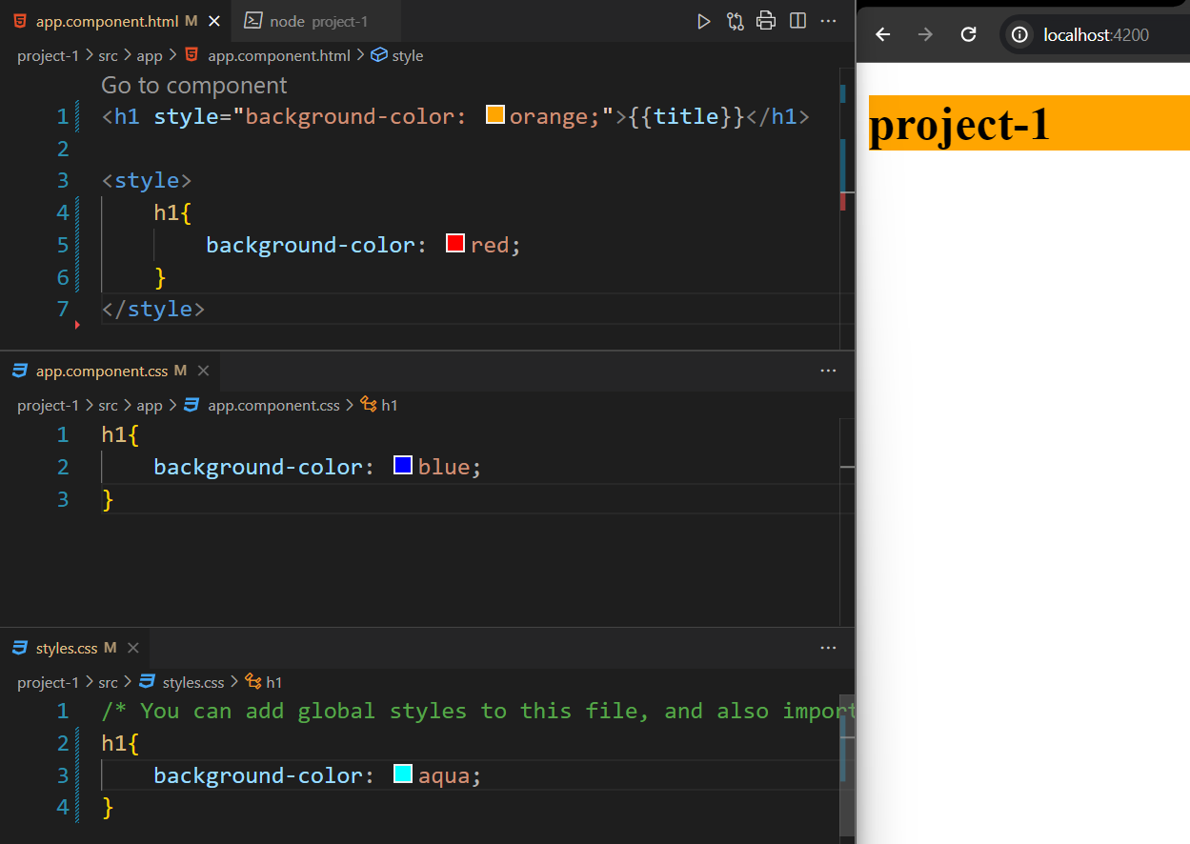
Style
Preference :-
Inline-style
<style> Tag in app.component.html
App.component.css
Style.css :- Global CSS

Slide 14
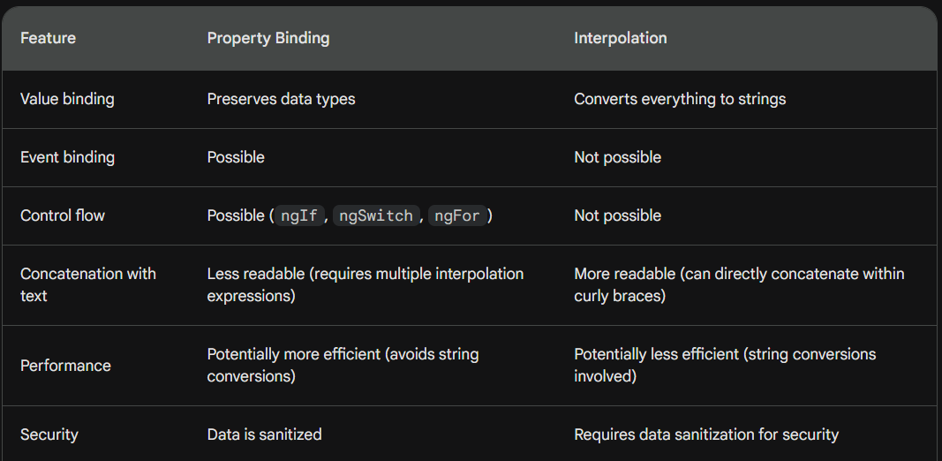
Property Binding VS Interpolation
Note :- Property Binding is much better than Interpolation
Interpolation takes true as true
Interpolation takes false as string i.e. true --→ Issue

Slide 15
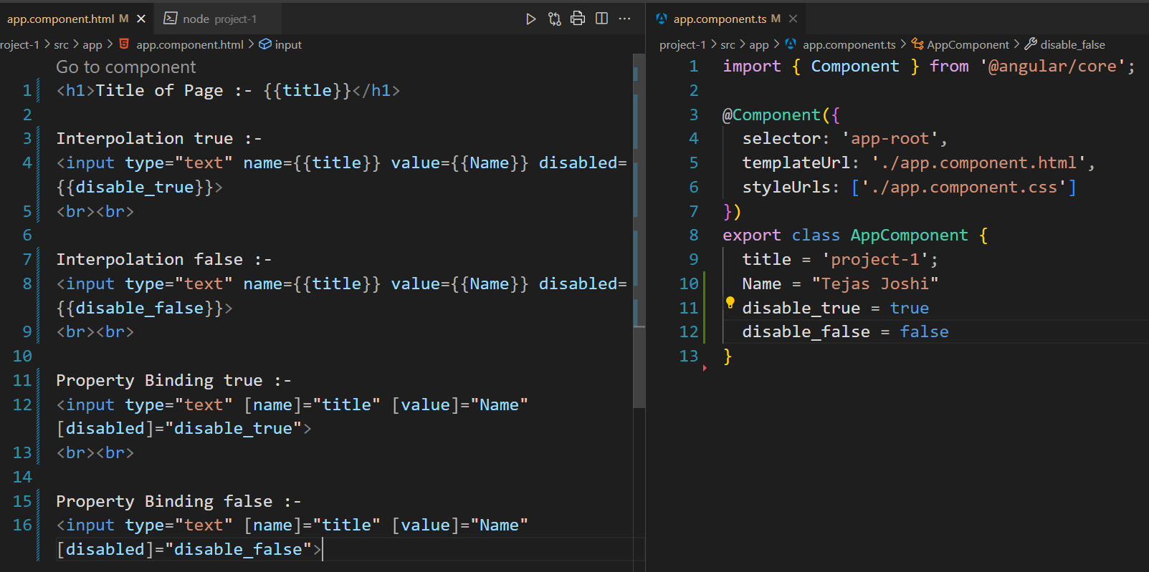
Property Binding VS Interpolation

Slide 16
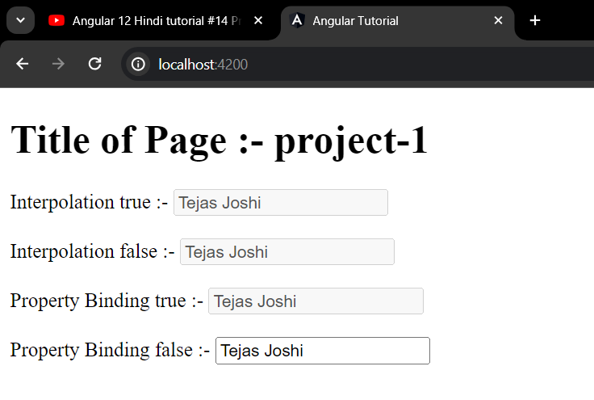
Property Binding VS Interpolation

Slide 17
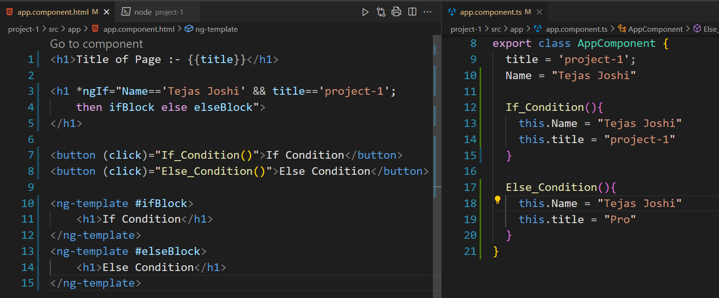
If-else Condition

Slide 18
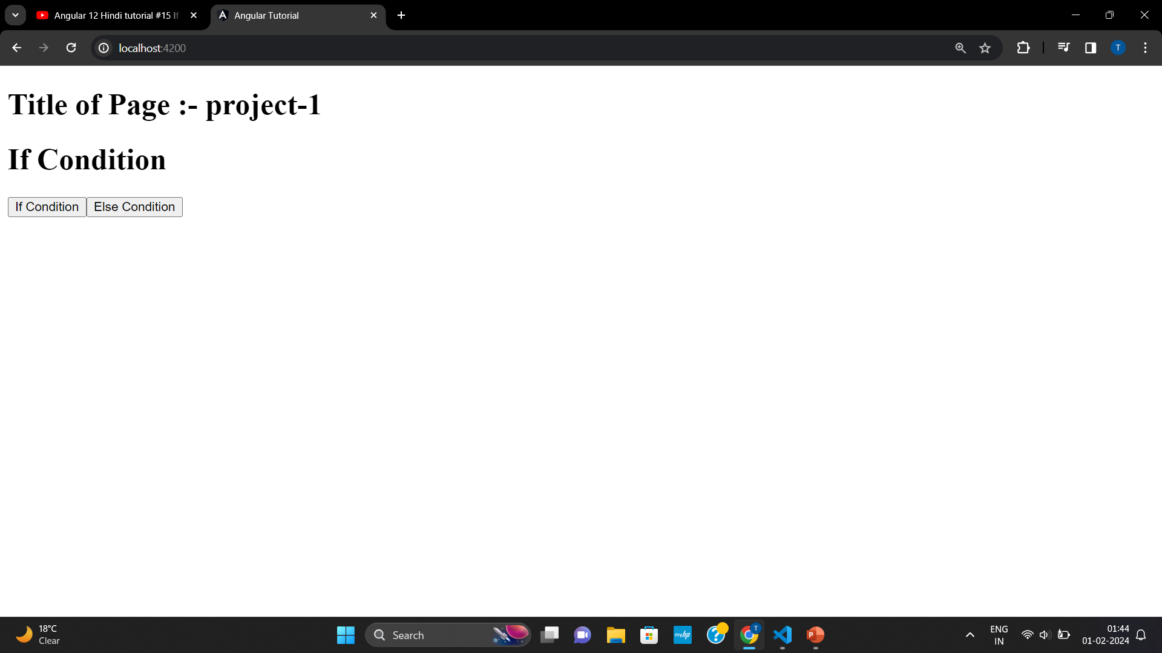
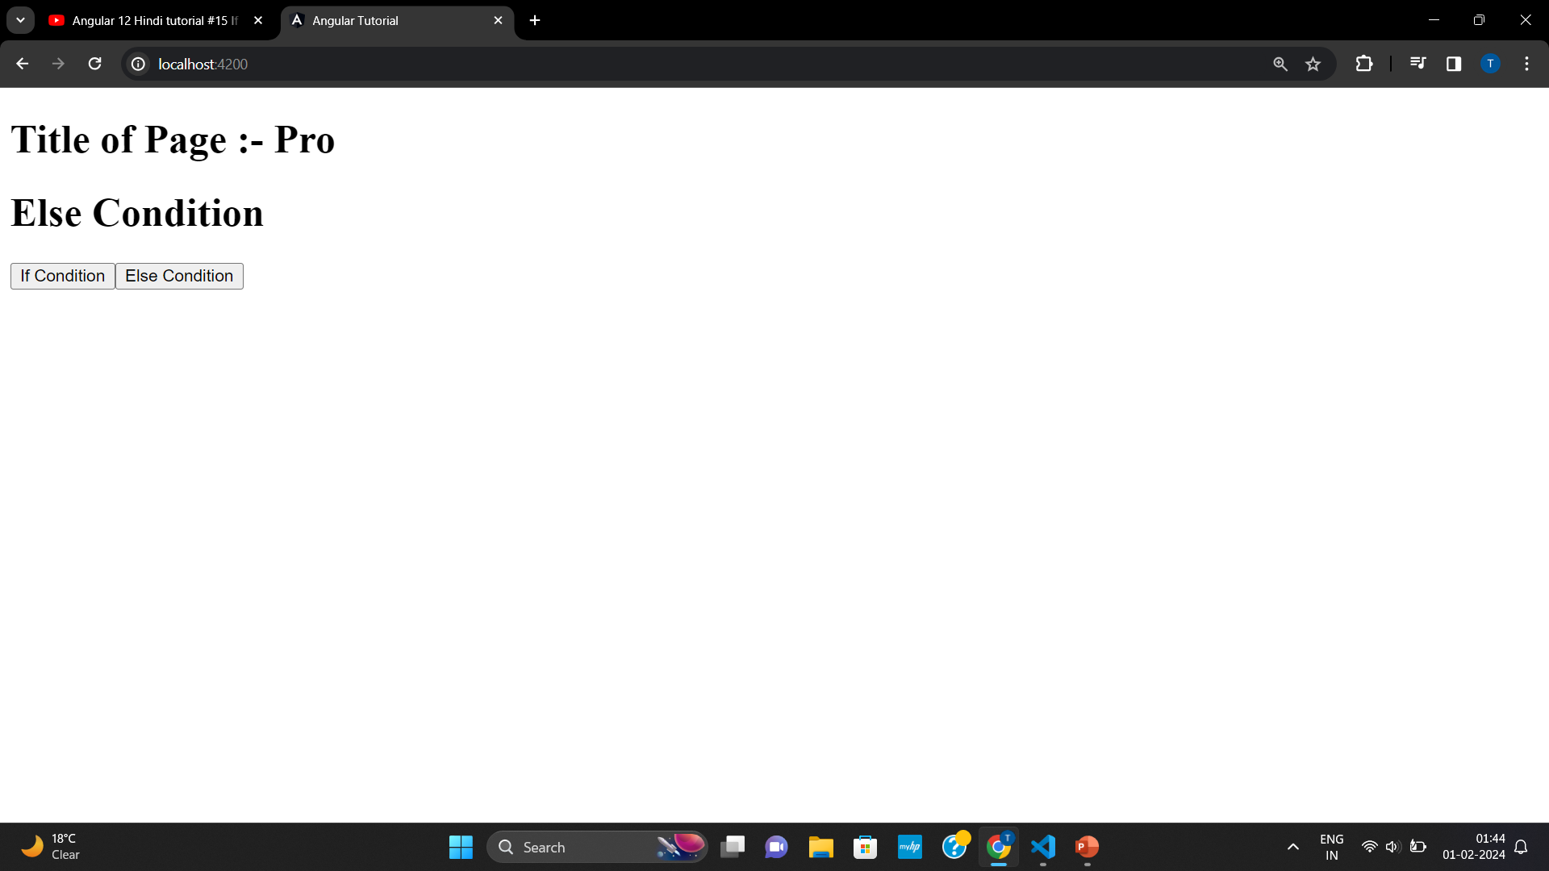
If-else Condition

Slide 19
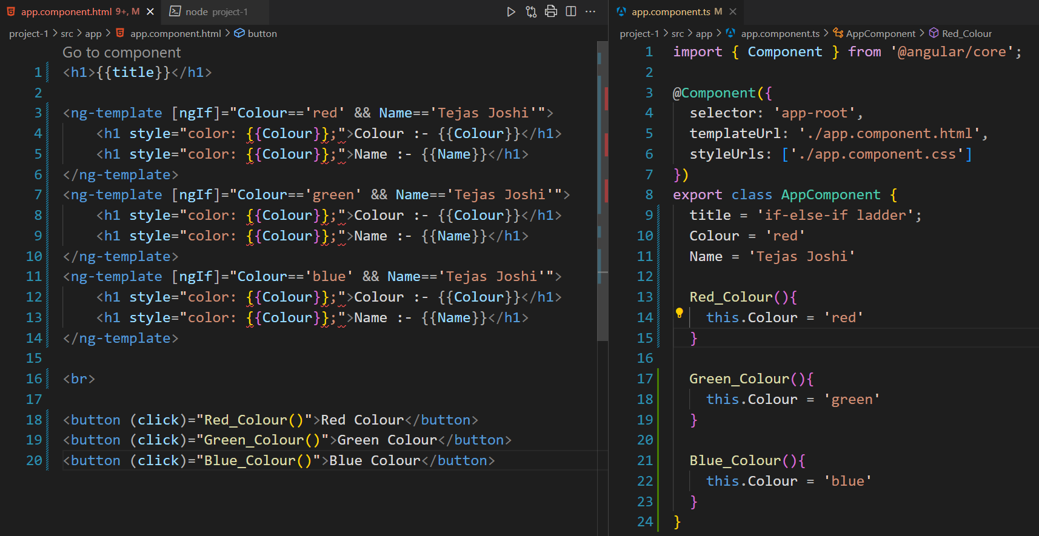
If-else-if ladder
If-else-if ladder not present in angular, we have to manually use if condition else we can user switch case condition

Slide 20
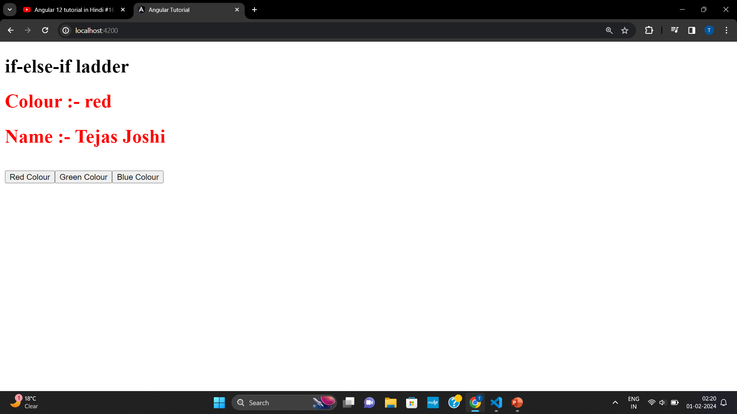
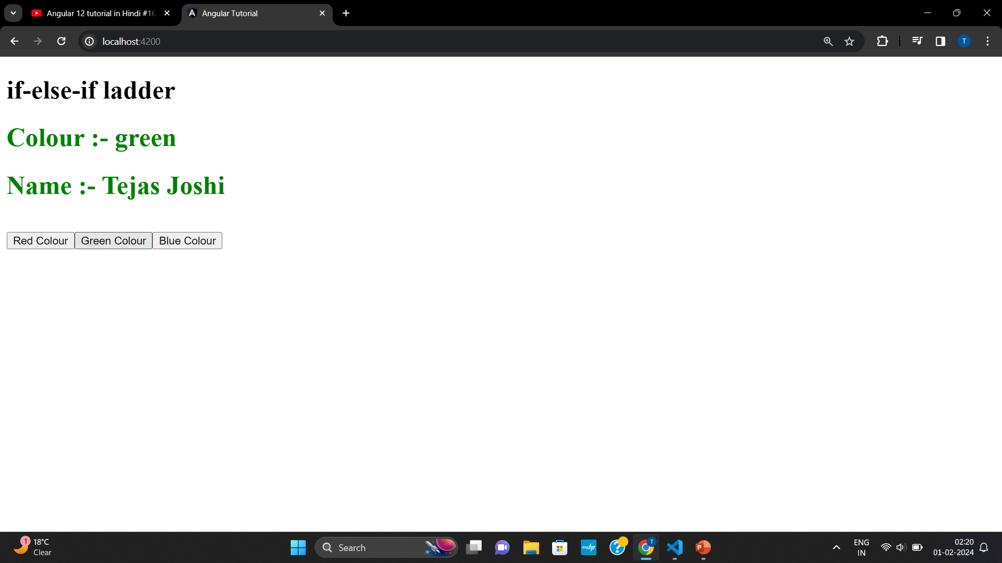
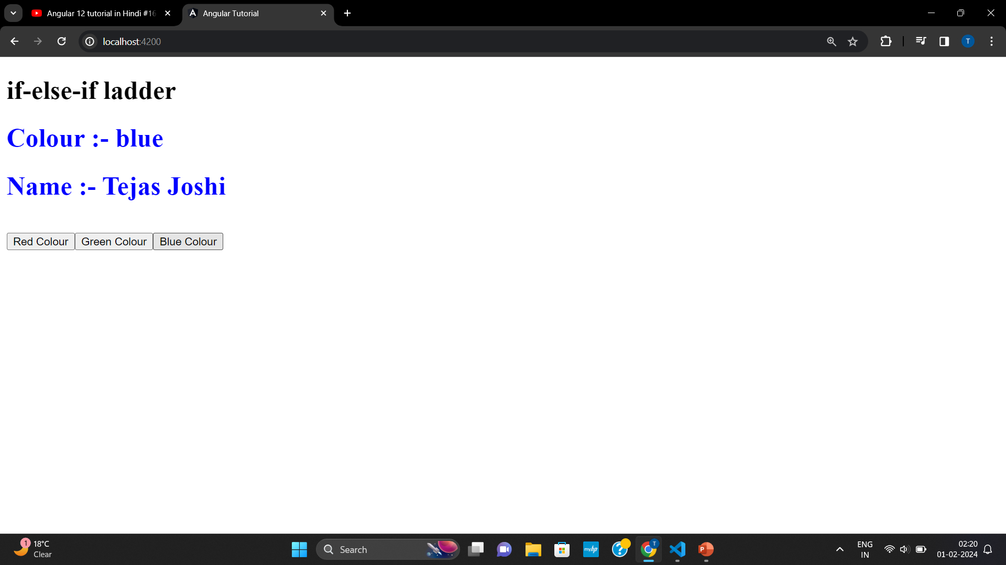
If-else-if ladder

Slide 21
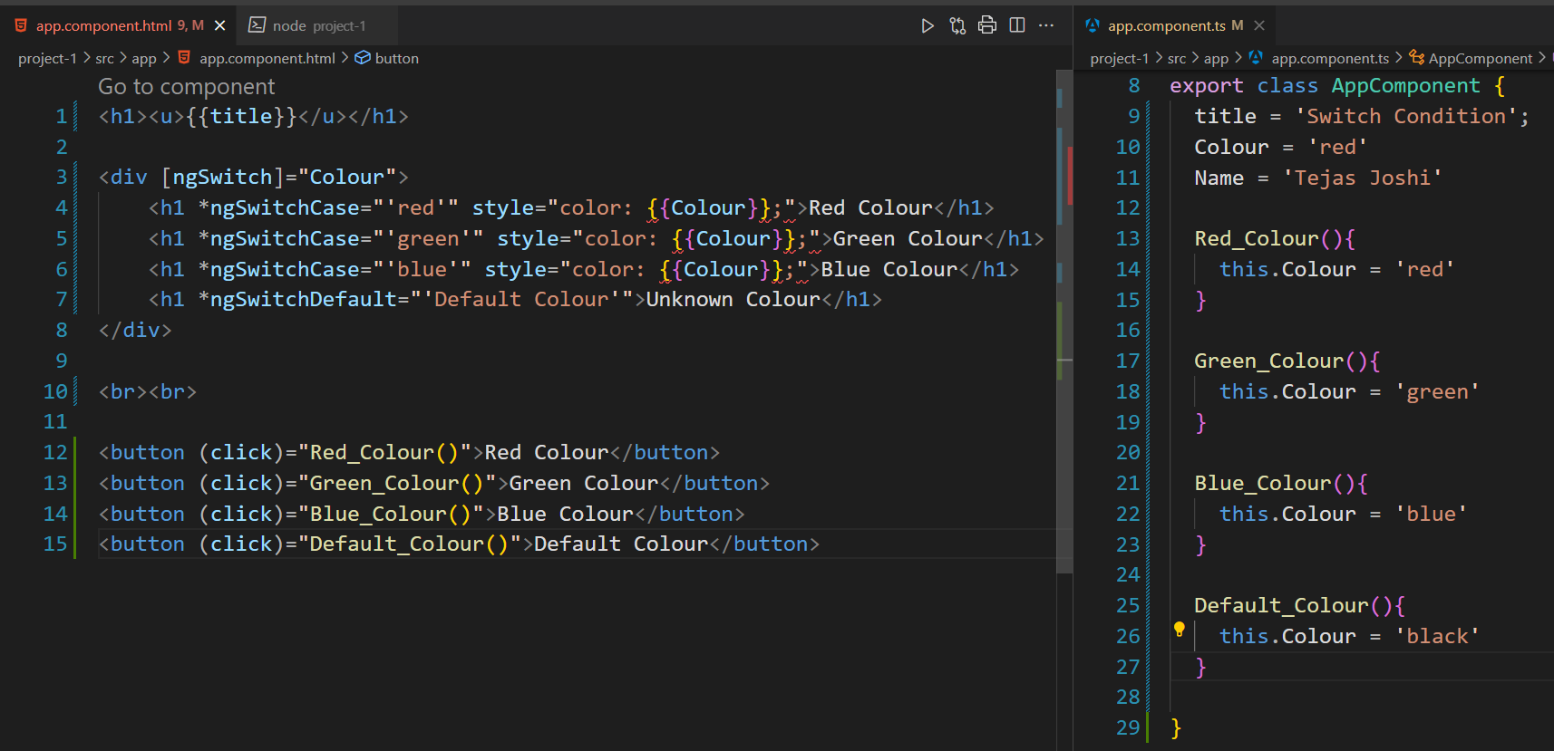
Switch Case

Slide 22
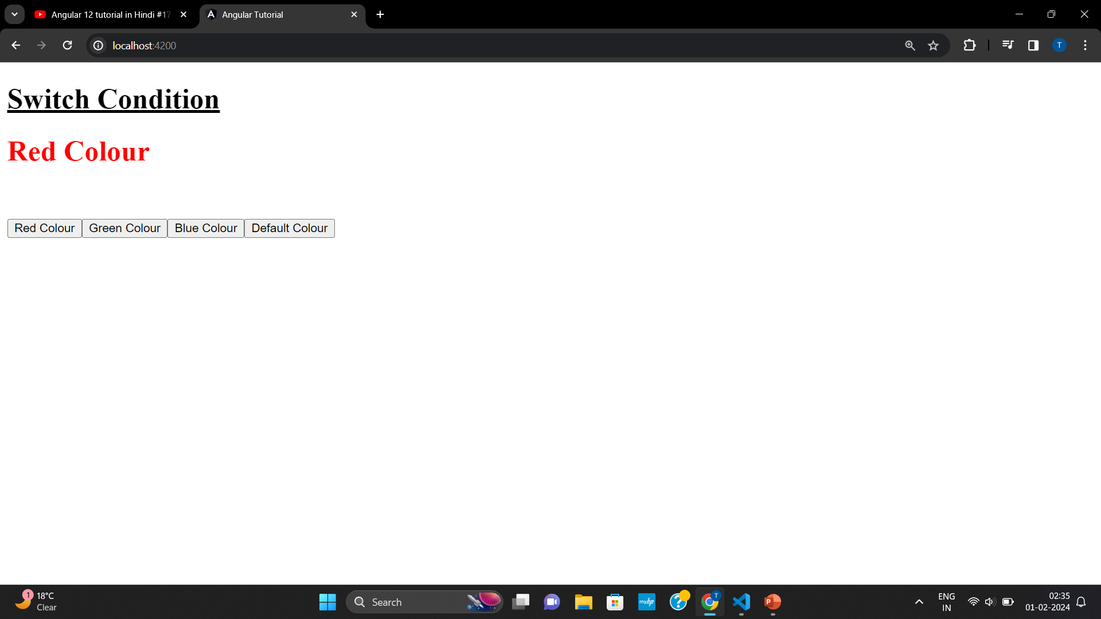
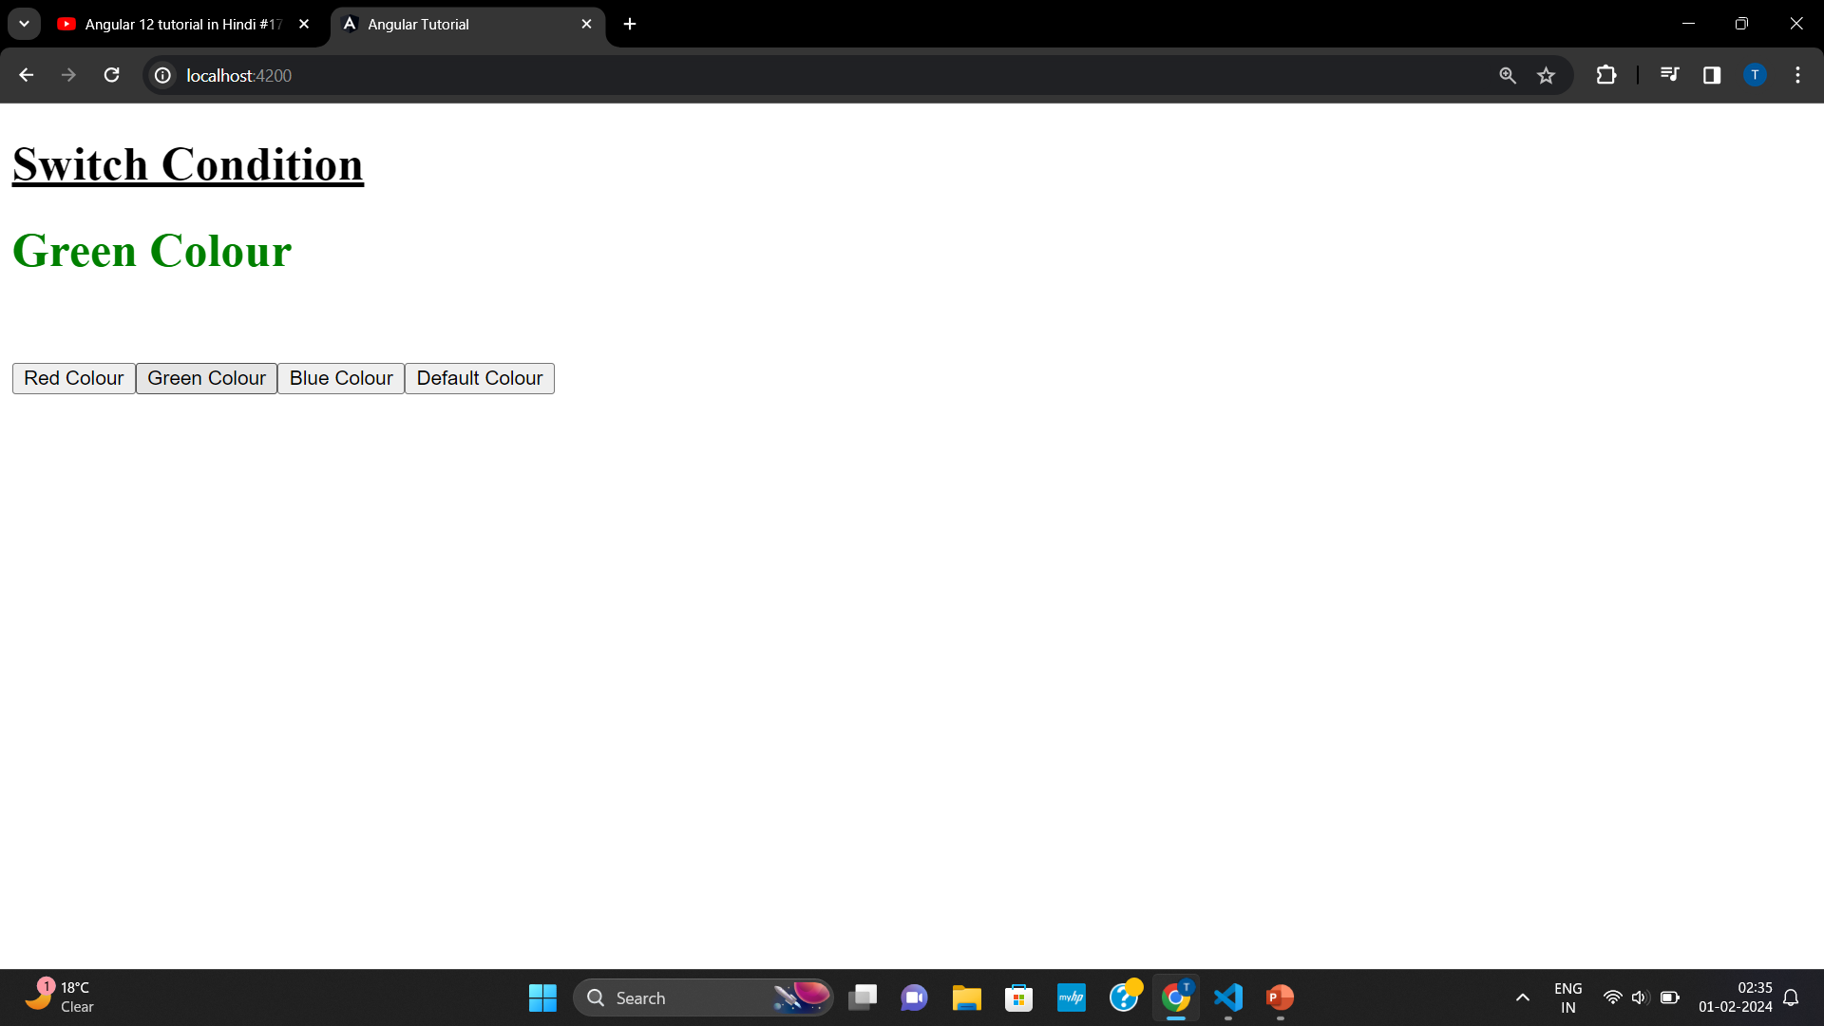
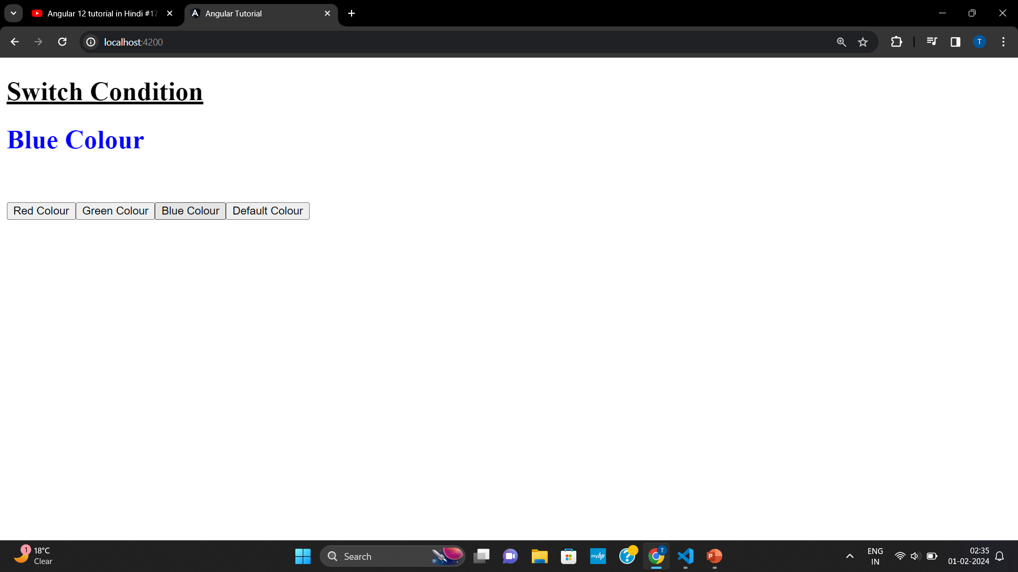
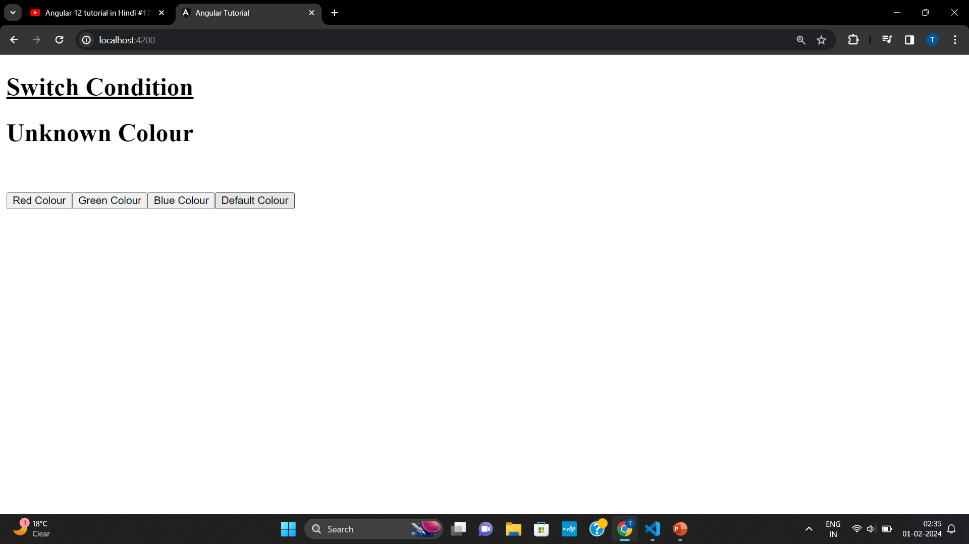
Switch Case

Slide 23
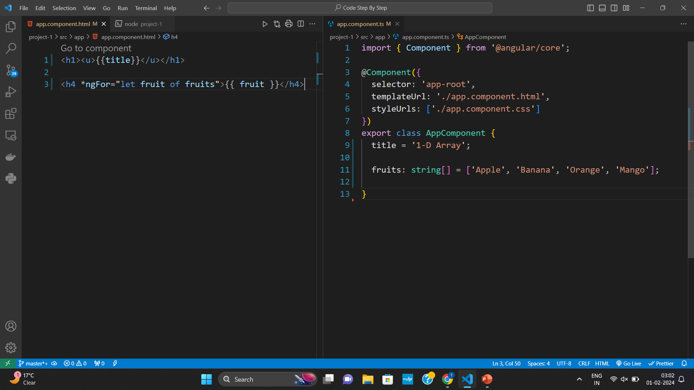
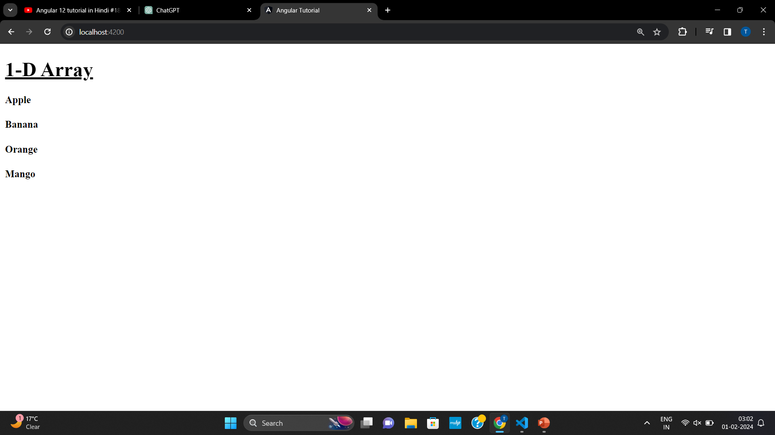
1-D Array

Slide 24
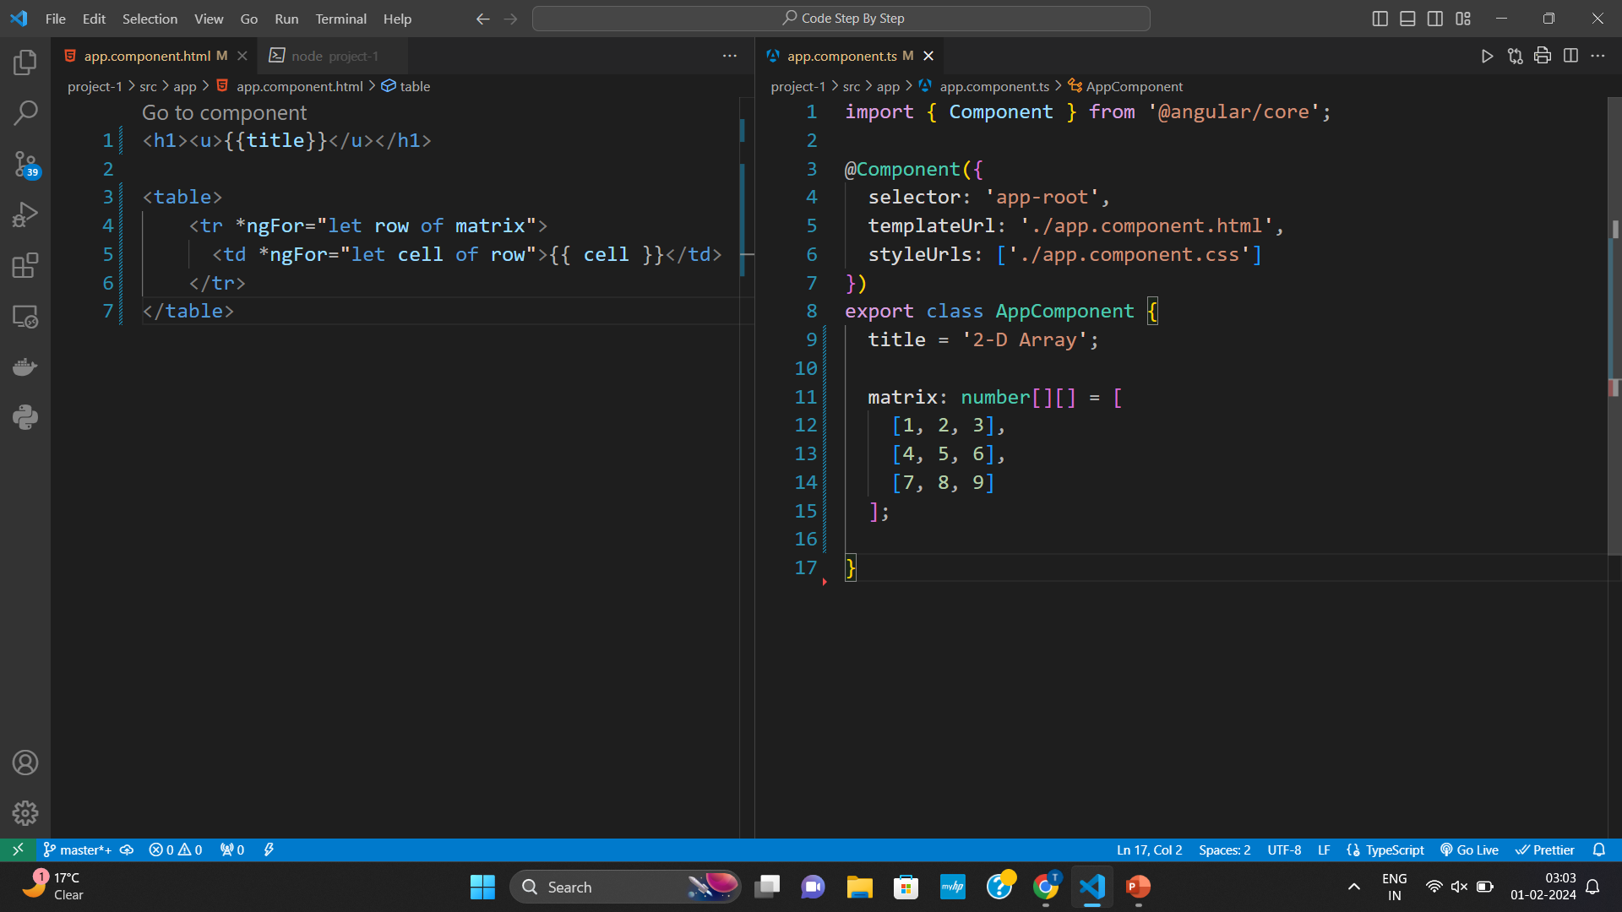
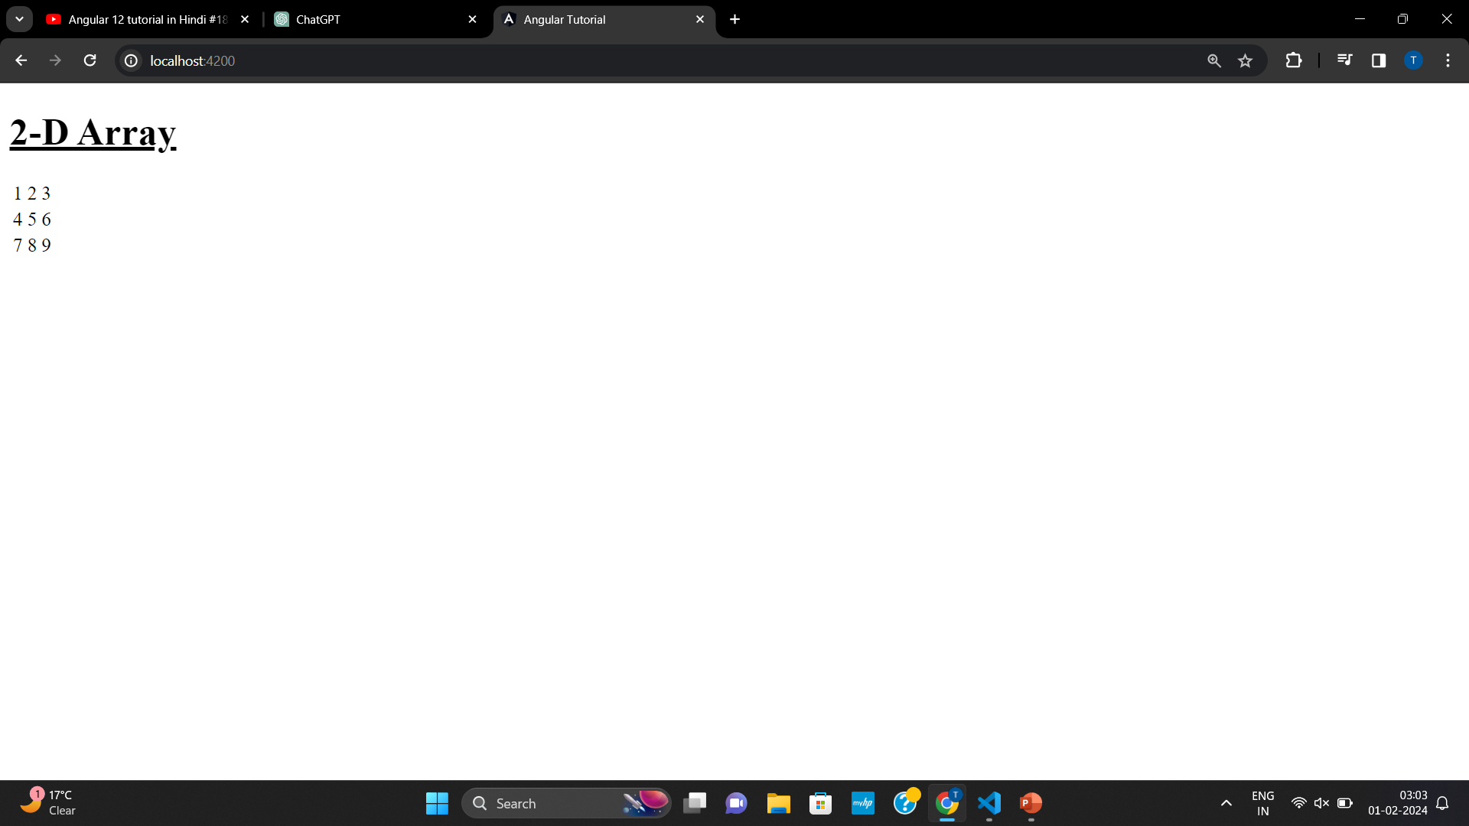
2-D Array

Slide 25
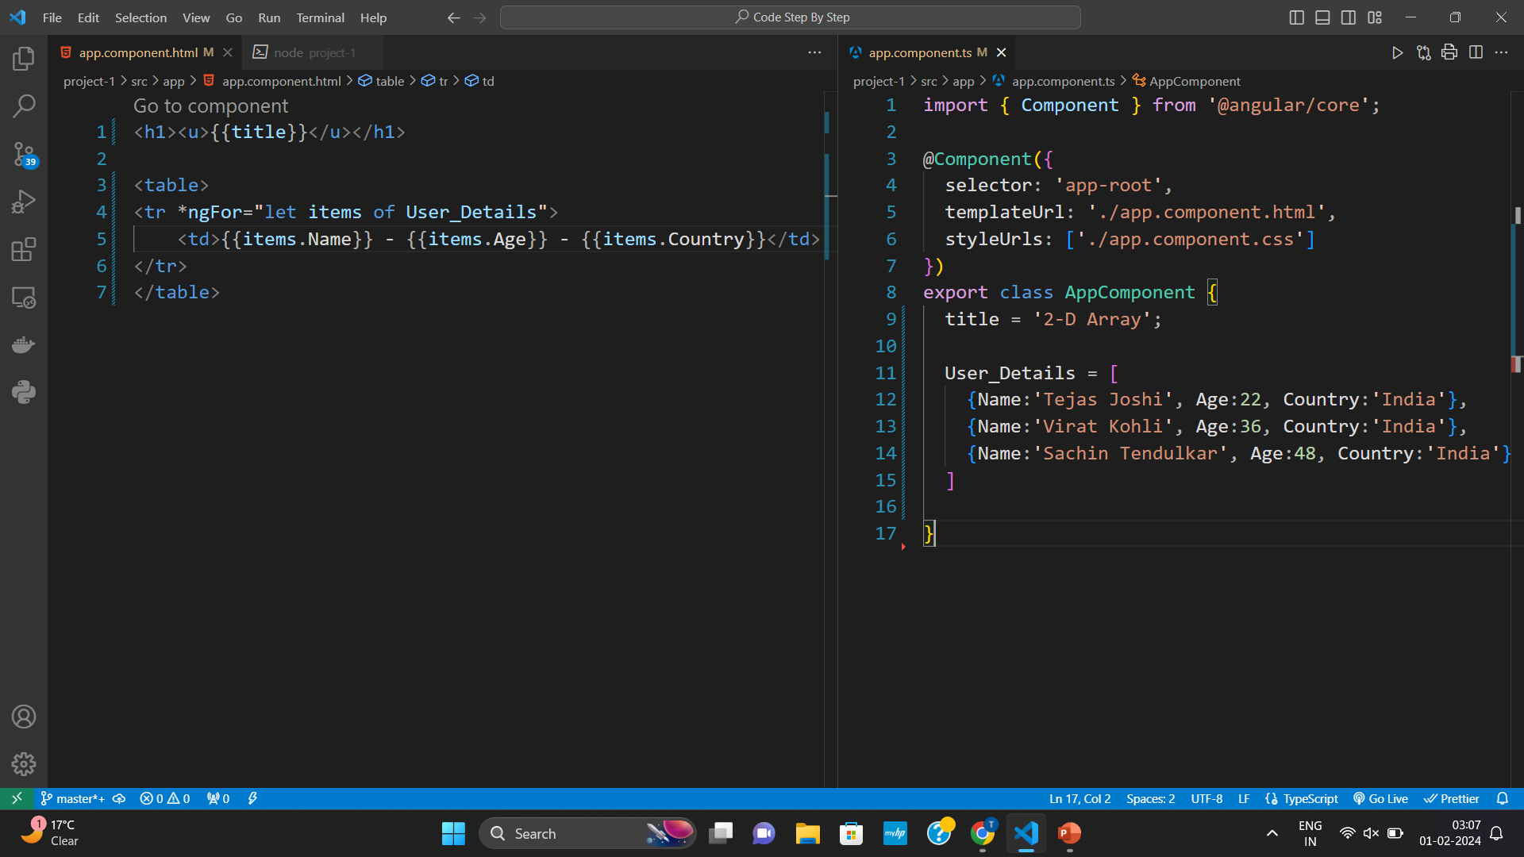
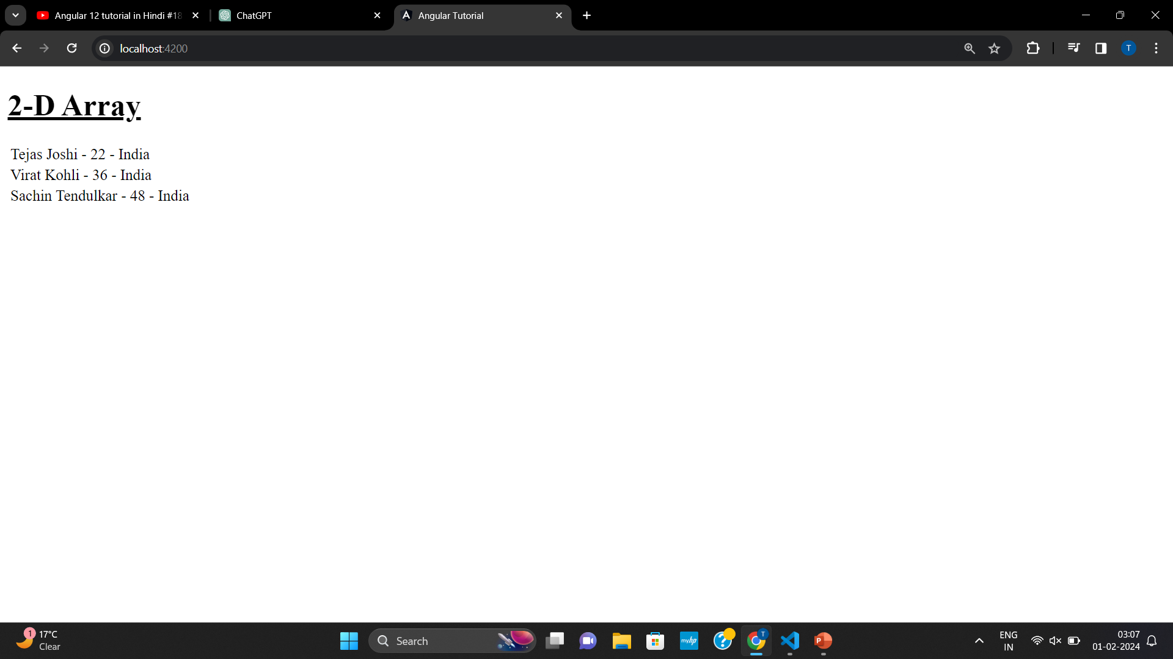
2-D Array

Slide 26
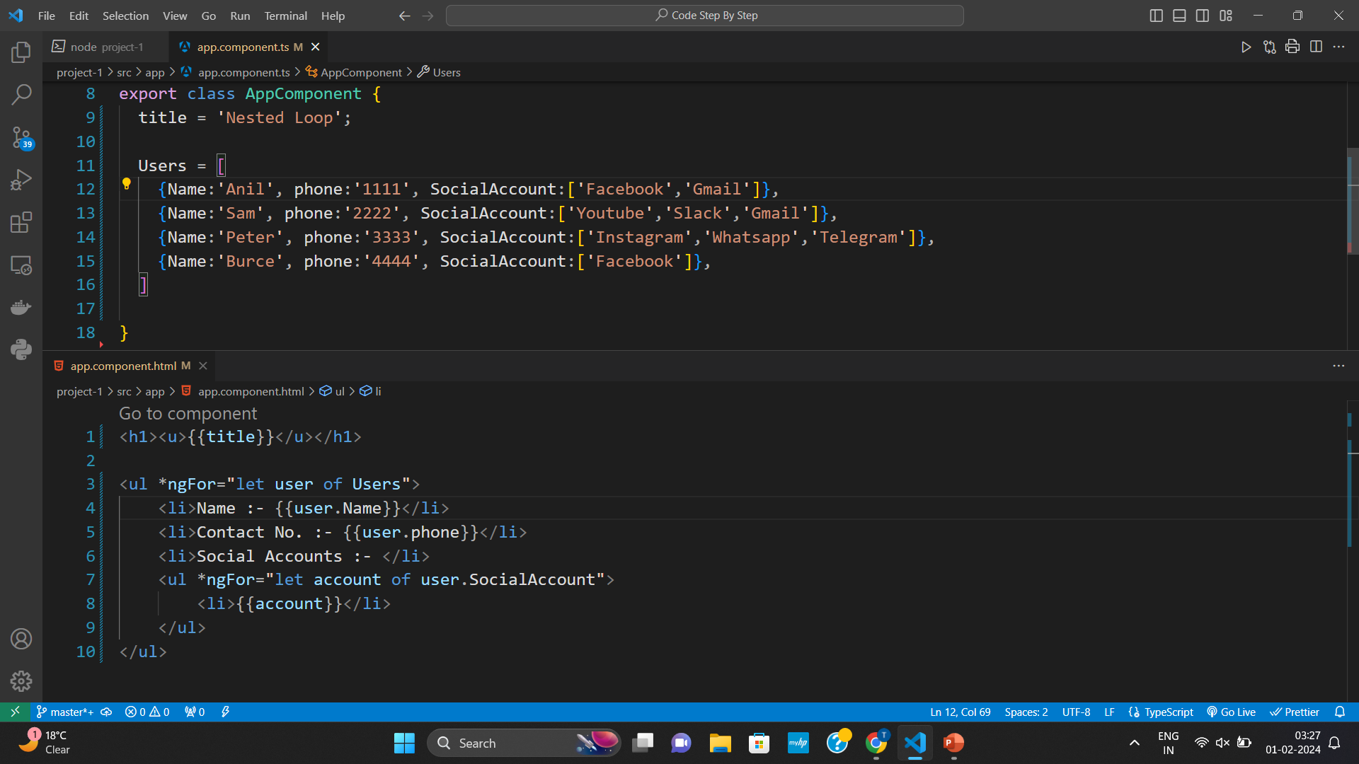
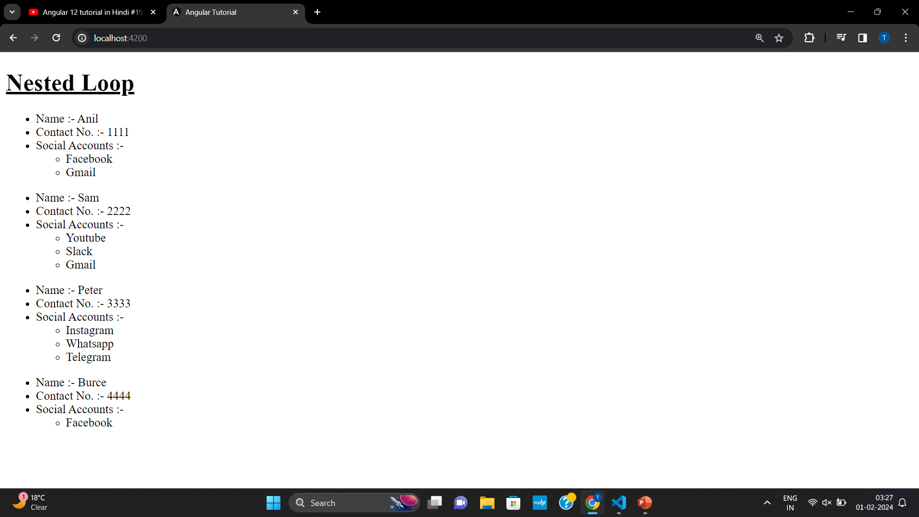
Nested Loop

Slide 27
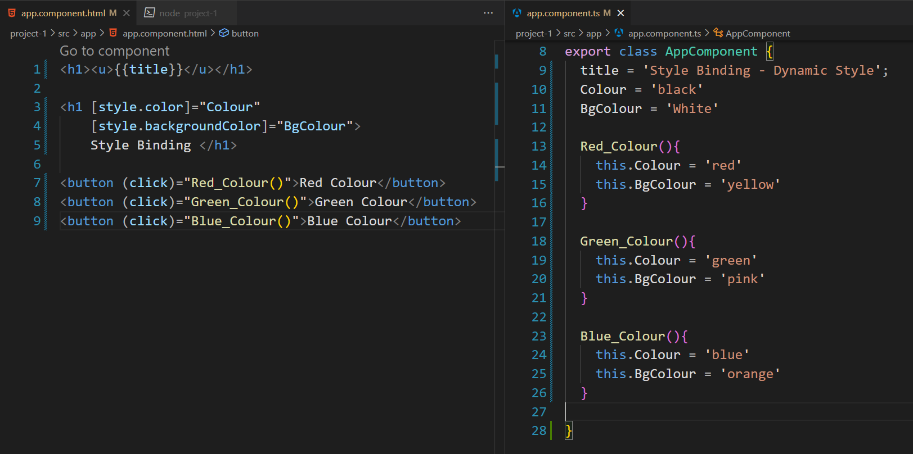
Style Binding

Slide 28
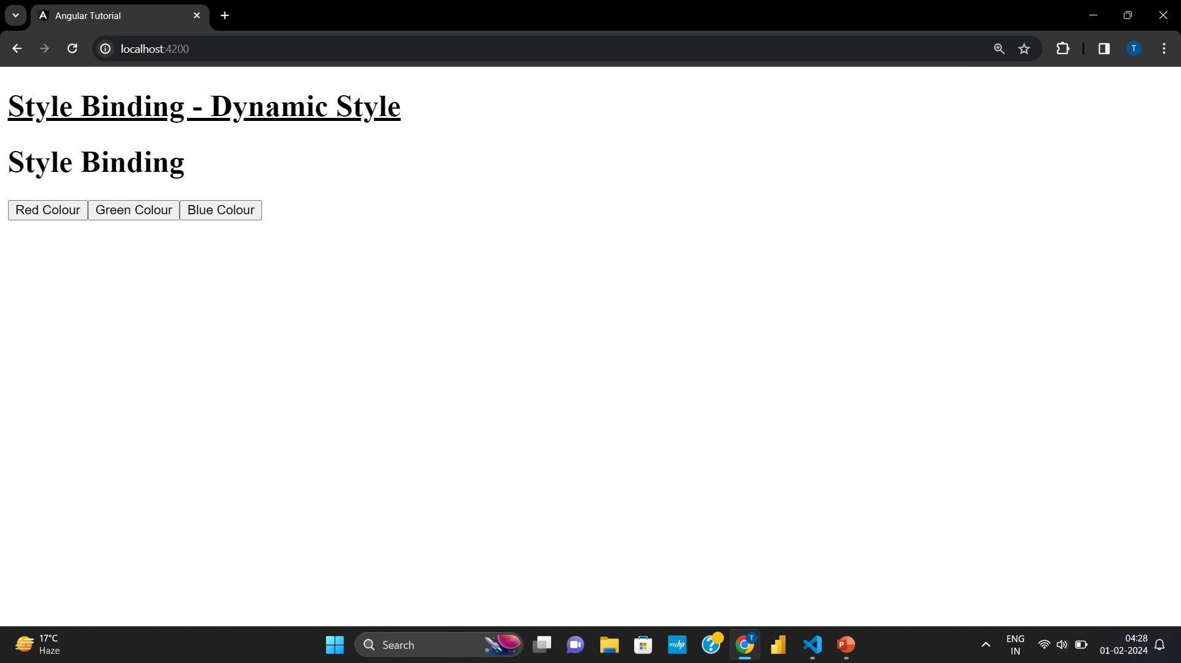
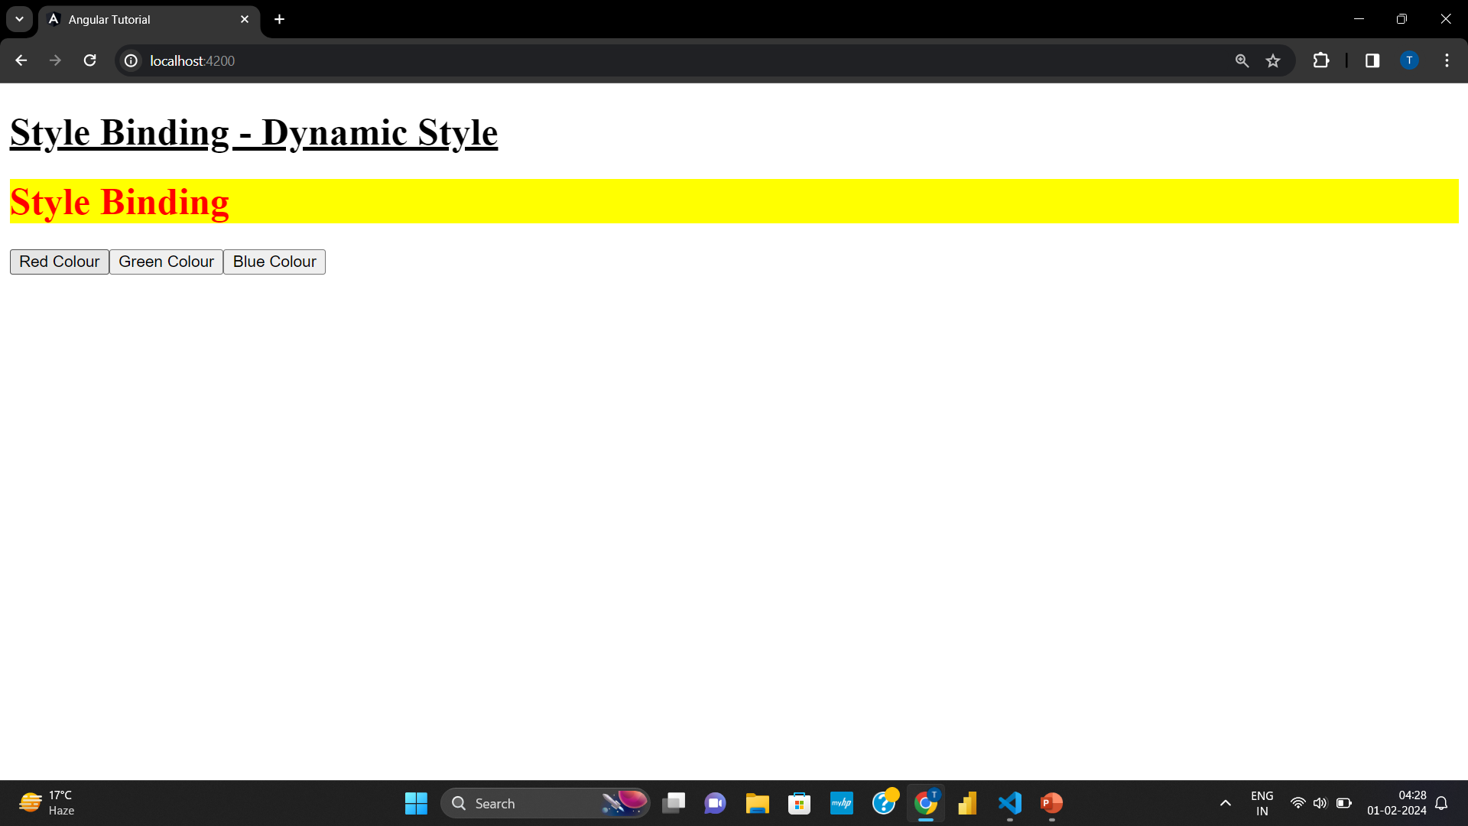
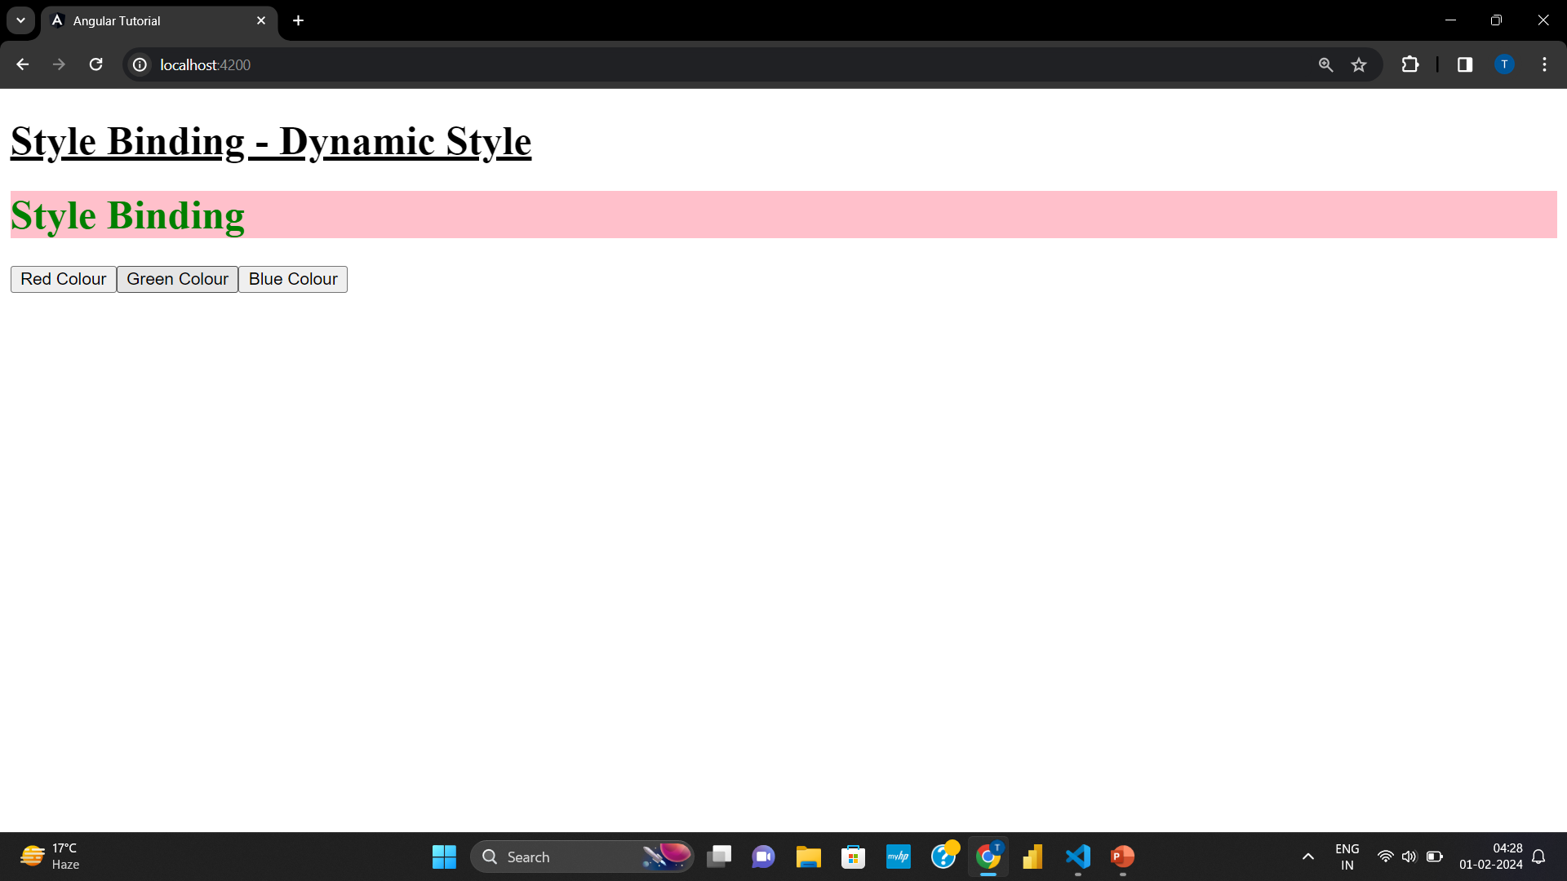
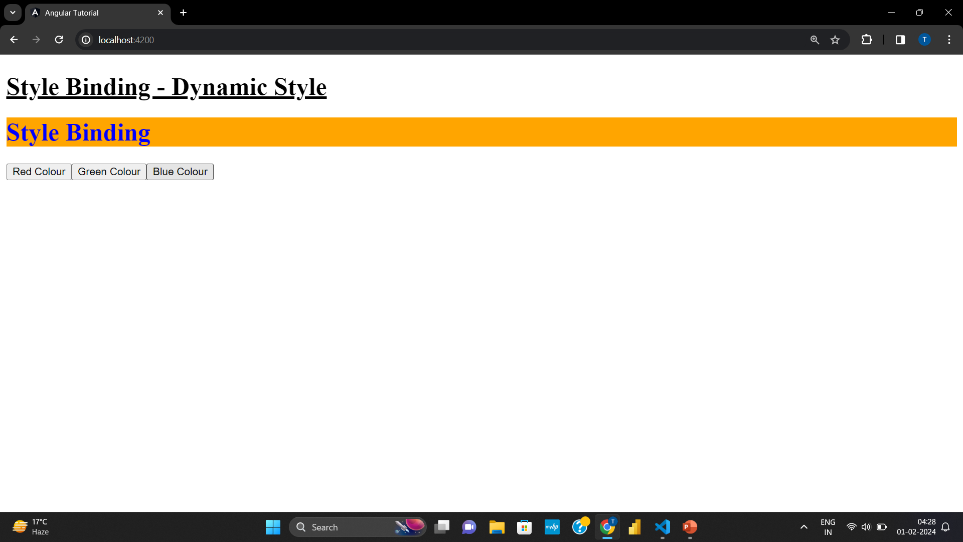
Style Binding

Slide 29
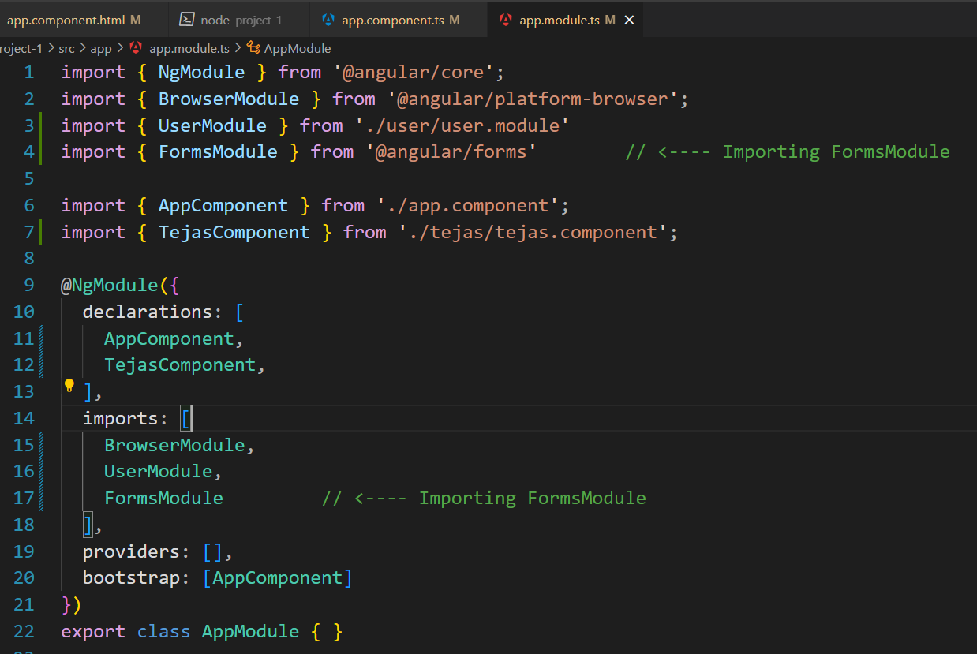
Angular Form

Slide 30
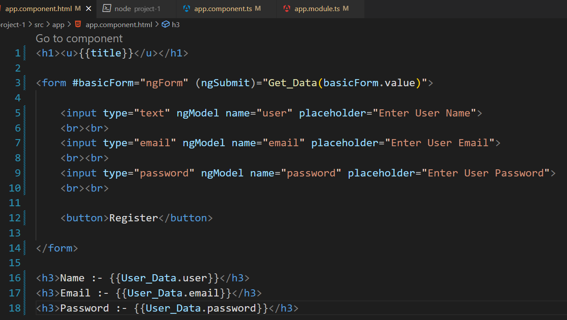
Angular Form

Slide 31
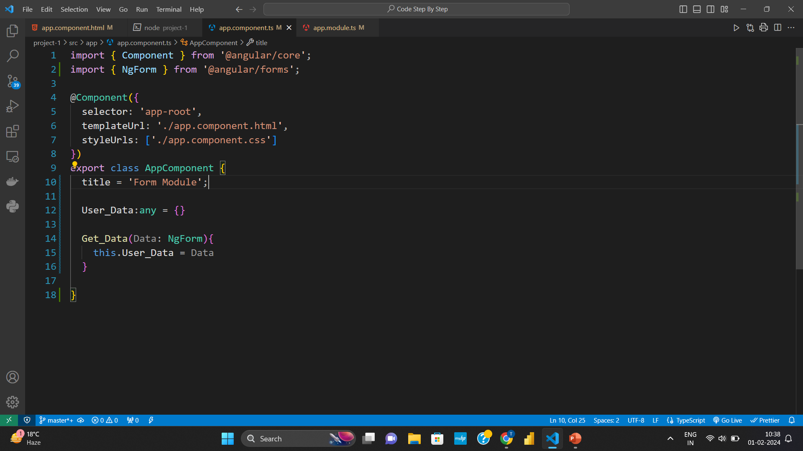
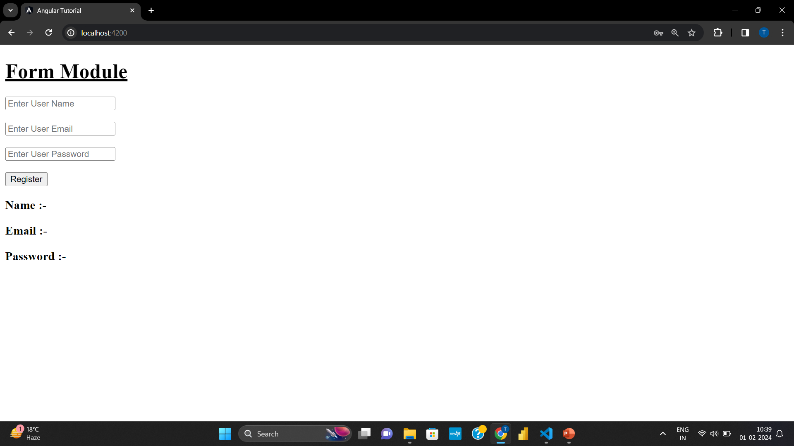
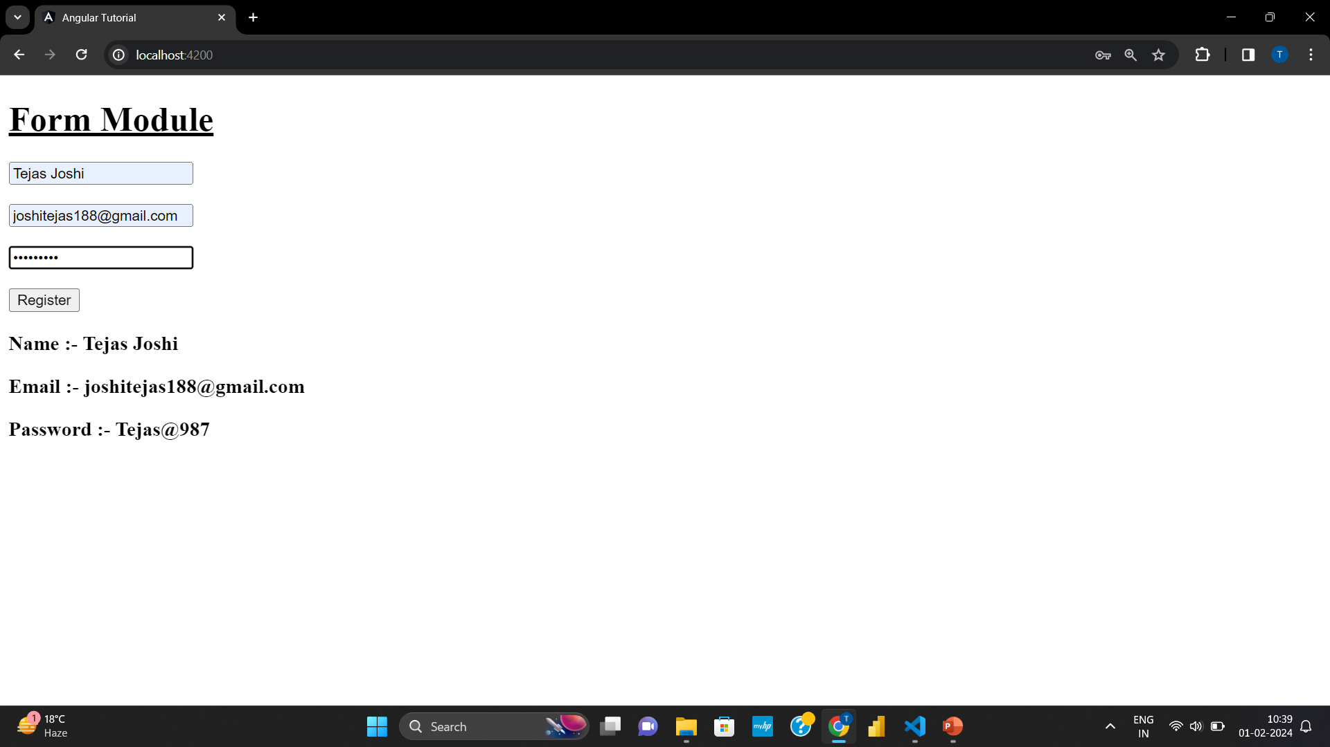
Angular Form

Slide 32
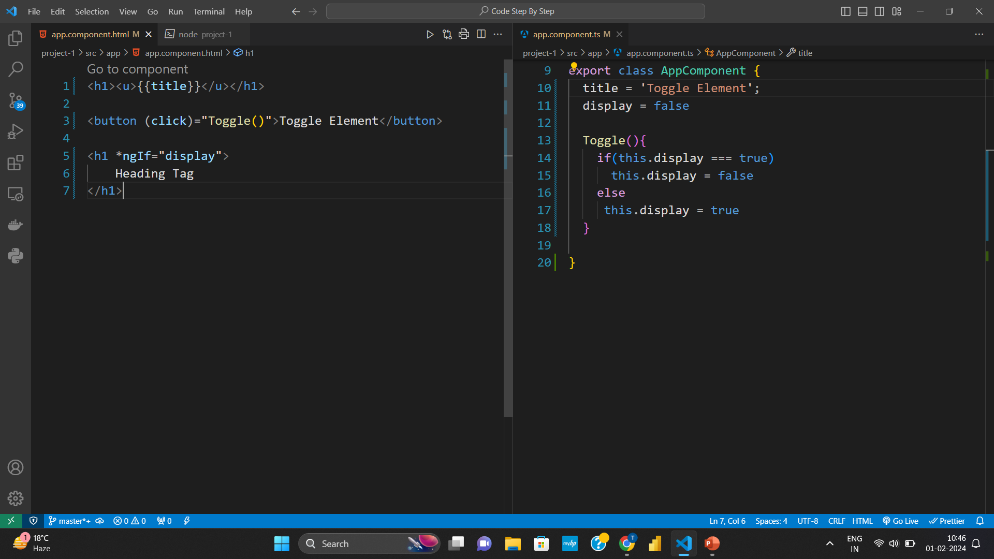
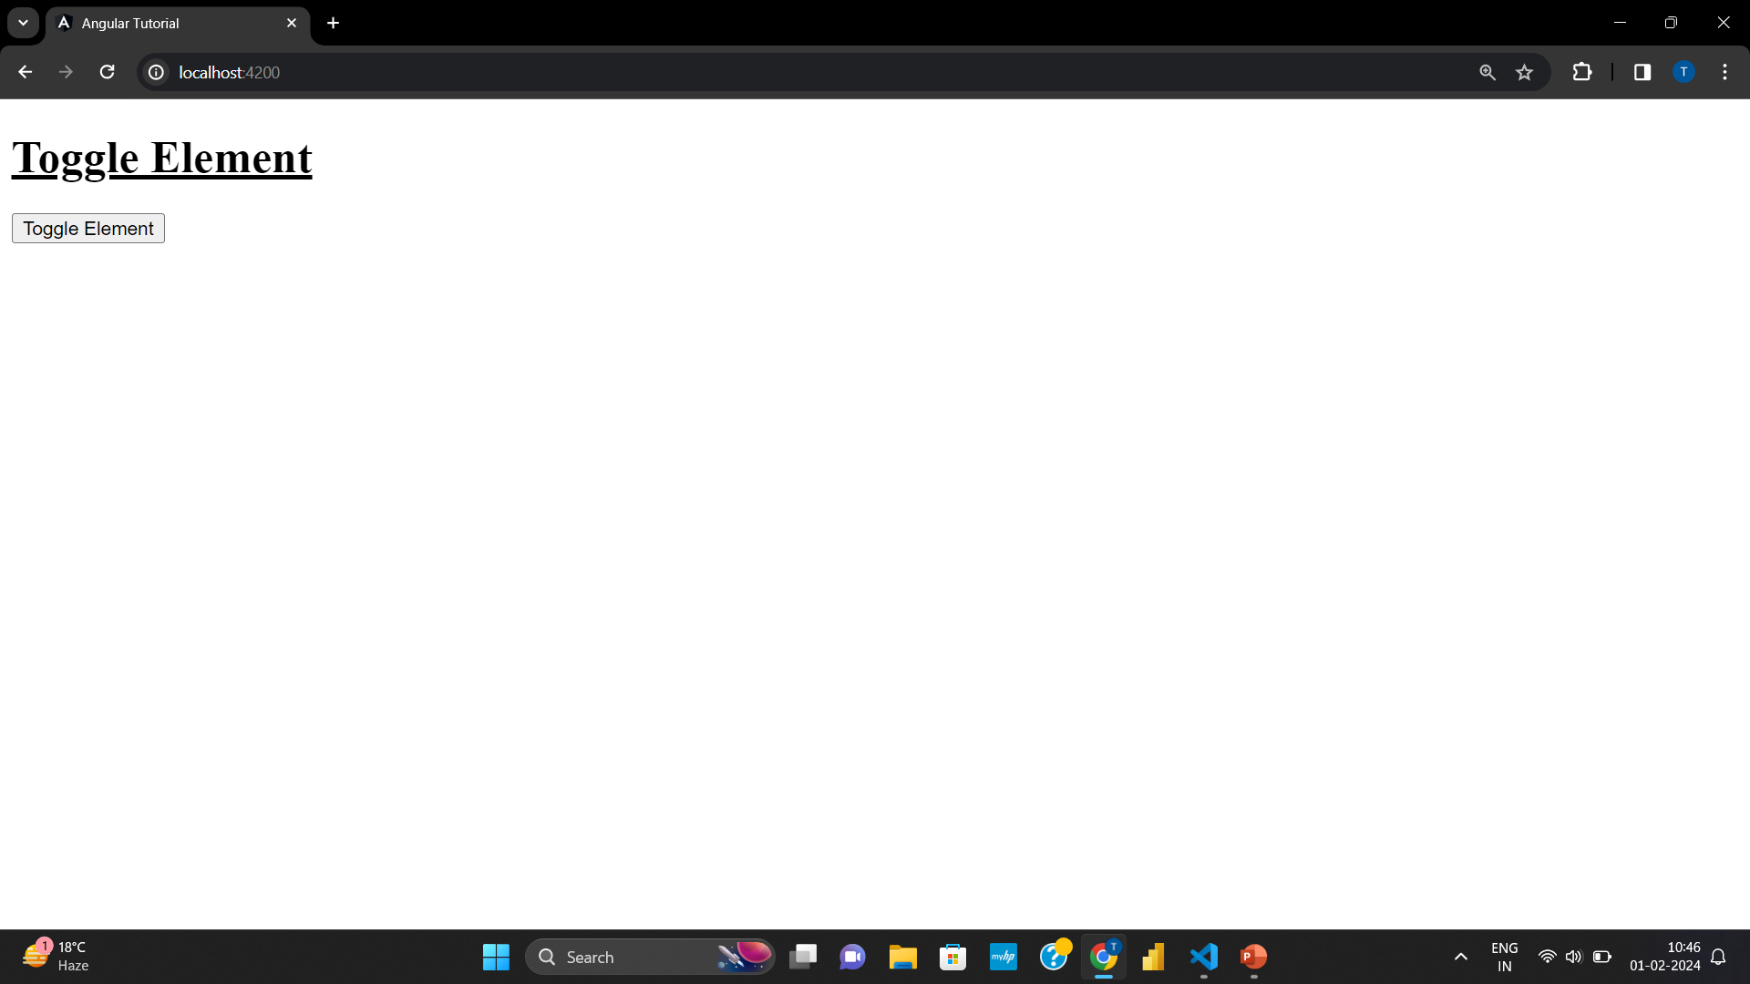

Toggle Element

Slide 33



Todo App

Slide 34

Send Data from Parent Component to Child Component

Slide 35

Send Data from Parent Component to Child Component

Slide 36




Send Data from Parent Component to Child Component

Slide 37
Reusable Component

Slide 38


Reusable Component

Slide 39

Reusable Component

Slide 40
Send Data from Child Component to Parent Component

Slide 41


Send Data from Child Component to Parent Component

Slide 42



Send Data from Child Component to Parent Component

Slide 43



Two-Way Binding
Two-Way Binding is use to update and display it’s value at same time

Slide 44
Two-Way Binding
Two-Way Binding is use to update and display it’s value at same time

Slide 45
Two-Way Binding
Two-Way Binding is use to update and display it’s value at same time

Slide 46
Two-Way Binding
Two-Way Binding is use to update and display it’s value at same time

Slide 47
Send Data from Child Component to Parent Component

Slide 48
Send Data from Child Component to Parent Component

Slide 49
Todo App

Slide 50
Todo App

Slide 51
Style Binding

Slide 52
Style Binding

Slide 53
Style Binding

Slide 54
Style Binding

